Slide 1
MACRA – MIPS
The Table is Set; What will be served?
HIMSS Austin Chapter
January 10, 2017

Slide 2
New Congress Guarantees Repeal of Affordable Care Act in 2017
What does it mean?
If past behavior predicts future behavior, look at the > 60 times a bill has passed the House for ACA repeal
Taxes
Mandates
Subsidies
Exchanges
Medicaid expansion

Slide 3
What’s not on the list?
The Mantra: Better Care with Lower Cost and improved Experience
MACRA and MIPS/APM’s are not part of the ACA – different law
Pretty much all of government paid healthcare is colloquially lumped into the term “Obamacare” which may include more than ACA
Many value-based programs including Meaningful Use started in the GW Bush Administration and a few in the Clinton Administration
MACRA – MIPS started January 1, 2017

Slide 4
Medicare Access and CHIP Reauthorization Act of 2015 (MACRA):
MACRA legislation, passed in April 2015
  MACRA removed the Sustainable Growth Rate (SGR) formula
  Minimum Annual Physician Fee Schedule (PFS) rate updates
  Established two Quality Incentive Programs:
    Merit Based Incentive Payment System: MIPS
    Advanced Alternative Payment Models: APMs
MIPS and APMs Both Intend to
  Improve quality and improve patient health
  Advance electronic medical records
  Control spending
  Provide Reimbursement Incentives for changing Clinical Practices
End game: Population Health Management

Slide 5
WHY MACRA/MIPS?
Change the way care is given and paid for by CMS
Change health delivery model to one based on Primary Care and Community-based care…and
Transform Primary Care to achieve desired results of Population Health and Alternative Payment Models
Move to risk-based Alternative Payment Models using Population Health methodology

Slide 6




With the Addition of Population Health, the Mission of Primary Care Expands
Acute, Episodic Care
Retail, walk-in model
Integration with ED
Urgent care services
Chronic Care and
Medical Home
Patient portal, home monitoring, telehealth
Managed self-care
Disease Management
Wellness
What is the role of a primary care physician in the new organization?
More manager than clinician?

Slide 7




Primary Care Coordinates Population Care
Advanced Clinical Practitioner
  Routine and Protocol Management
Office Delivery Model
  Care coordination and communication
Physician
Clinical Role
Complexity
Exceptions
Management Role
Strategic Role
Patient Portal and Self Care
How is your Board supporting these changes in primary care delivery?
How is your Board supporting physicians going through these changes?

Slide 8

IMAGINE…
THERE’S NO FEE FOR SERVICE…
IT’S EASY IF YOU TRY

Slide 9
MACRA - Medicare Access and CHIP Reauthorization Act of 2015
Changing How Physicians and other Providers Are Paid while Driving Practice Transformation
Two ways to participate:
Changing How Physicians and other Providers Are Paid while Driving Practice Transformation
Two Ways to participate
  MIPS (Merit Based Incentive Payment System) – most practices
    Quality
    Resource Utilization
    Clinical Practice Improvement
    Advancing Care Information (MU)
  Advanced Alternative Payment Models (APM) – contracting for risk
    Next generation ACO (risk)
    Medicare Advantage
    Comprehensive Primary Care Plus
    Patient Centered Medical Home
MIPS (Merit Based Incentive Payment System) – most practices
Quality
Resource Utilization
Clinical Practice Improvement
Advancing Care Information (MU)
Advanced Alternative Payment Models (APM) – contracting for risk
Next generation ACO (risk)
Medicare Advantage
Comprehensive Primary Care Plus
Patient Centered Medical Home

Slide 10
MACRA – MIPS Summary for HIMSS members
What it is : Payment Reform for Medicare Part B
Who it impacts: Eligible Clinicians subject to the Medicare physician fee schedule
IT is involved: continue Certified Electronic Health Record and Meaningful Use for physicians and other EC’s
IT involved : support reporting for Quality, Claims and Clinical Improvement
IT involved : one of three imperatives for success in Population Health and risk payment methodology

Slide 11

Merit Based Incentive Payment System (MIPS):
Applicable to Professional Service Providers - Clinicians
MIPS will apply to following Clinicians:
Physicians
Medicine and osteopathy
Dental surgery
Podiatric medicine
Optometry
Chiropractors
Mid-level practitioners
Physician assistants (PAs)
Nurse practitioners (NPs)
Clinical nurse specialist (CNS)
Certified registered nurse anesthetists (CRNAs)
CMS will add other professionals in 2021
Physical, speech and occupational therapist
Audiologist
Others reimbursed under Physician Fee Schedules

Slide 12
Clinicians Exempt from MIPS
Low CMS volume physicians (<100 patients or $30K)
Non-patient facing physicians
Physicians practicing at Critical Access Hospitals
MIPS not applicable to RHCs and FQHCs
The intention is to exclude small practices; estimated about 50% of physicians will be excluded initially. HOWEVER…
For the Quorum family, the good news is we have had good participation in NRACO, and many will be exempt…AT FIRST

Slide 13
If exempt, why care about MACRA / MIPS?
While CAH and RHC’s are exempt from initial implementation, any provider outside of these entities will be impacted
In the Alternative Payment Model CMS is soliciting commercial payers to “play” in the same structures
Commercial payers are likely to move to risk contracts as fast as the market will allow
CMS will likely converge all payment methodology as rapidly as politically feasible
?
While CAH and RHC’s are exempt from initial implementation, any provider outside of these entities will be impacted
In the Alternative Payment Model, CMS is soliciting commercial payers to “play” under the same structures
Commercial payers are likely to move to risk contracts as fast as the market will allow
CMS will likely converge all payment methodology as rapidly as politically feasible

Slide 14
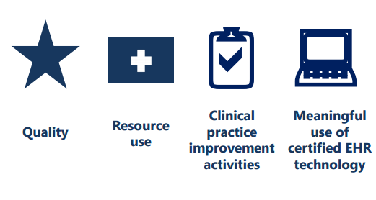
How does MIPS work? – select measures and start 2017
A single MIPS composite performance score will factor in performance in 4 weighted performance categories:
Advancing
Care Information
New
MIPS Composite Performance Score
Based on the MIPS composite performance score, physicians and practitioners will receive positive, negative, or neutral reimbursement adjustments

Slide 15
Soft Launch vs. Full Launch
OPTIONS:
Full Year reporting period – preferred – maximum gain available in 2019
90 – day reporting period – probably neutral
No reporting = certain penalty in 2019

Slide 16
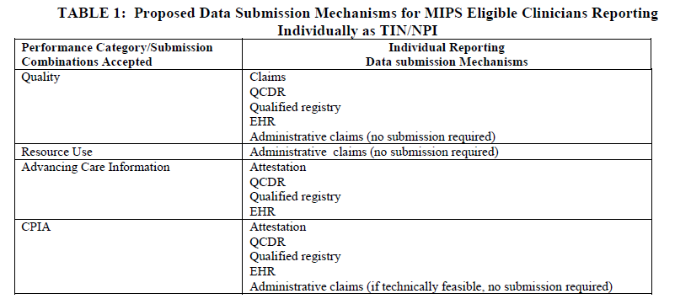
Submitting Data to CMS for MIPS Performance Scores
Table 1: Proposed Data Submission Mechanisms for MIPS Eligible Clinicians Reporting Individually as TIN/NPI
Performance Category/Submission Combinations Accepted | Individual Reporting Data Submission Mechanisms
Quality | Claims QCDR(Qualified Clinical Data Registry) Qualified registry EHR Administrative claims (no submission required)
Resource Use | Administrative claims (no submission required)
Advancing Care Information | Attestation QCDR Qualified registry EHR
CPIA | Attestation QCDR Qualified registry EHR Administrative claims (if technically feasible, no submission required)

Slide 17
MIPS – Four Determinants of Performance Score
Quality Reporting (60%)
  Chose six metrics to report by end of 2016 for performance year 2017
  Similar to PQRS – use same metrics and reporting system
Advancing Care Information (25%) – Replaces Meaningful Use
  Dropping CPOE and decision support requirements after 2017
  Very similar to current Meaningful Use requirements
Clinical Practice Improvement Activities (15%)
  Flexible – can choose from 90 options – this is new
    Examples include – care coordination; 24/7 access
Resource Utilization (0% - increases in coming years with decrease weight on quality)

Slide 18
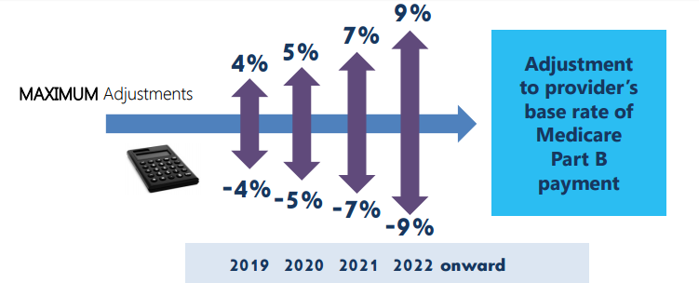

MIPS Is Budget-neutral for CMS
9%
7%
5%
Adjustment to provider’s Medicare Part B payment
4%
MAXIMUM Adjustments
-4%
-5%
-7%
-9%
2019 2020 2021 2022 onward

Slide 19
MIPS advancing care information objectives and measures
Replaces Meaningful Use as of calendar 2018 (note MIPS applies to eligible providers and not to hospital participation in Medicare EHR Incentive program or Medicaid EHR Incentive Program)
Six Criteria
  Protect Patient Health Information – Security Risk Analysis
  Electronic Prescribing
  Patient Electronic Access – Patient Access, Patient-specific education
  Coordination of Care Through Patient Engagement – View/Download/Transmit, Secure Messaging, Patient Generated Health Data
  Health Information Exchange – Patient Record Exchange, Request/Accept Patient Care Record, Clinical Information Reconciliation
  Public Health and Clinical Data Registry Reporting – Immunization Registry Reporting

Slide 20
Advancing Care Information To-Do’s
For the period Jan 1, 2017 to December 31, 2017, clinician must:
Use 2014 or 2015 Edition Certified EHR
Report on either eight stage 2 or six stage 3 advancing care information objectives and measures
Attest to their cooperation in good faith with the surveillance and ONC direct review of the EHR
Attest to their support for health information exchange and the prevention of information blocking

Slide 21
MIPS Proposed Rule:
Advancing Care Information Scoring and Measures
Table 9: Sample Performance Score
Objectives | Patient Electronic Access |  | Coordination of Care Through Patient Engagement |  |  | Health Information Exchange (HIE)
Measures | Patient Access | Patient-Specific Education | VDT | Secure Messaging | Patient-Generated health Data | Patient Care Record Exchange | Request/Accept Patient Care Record | Clinical Information Reconciliation
Performance Rate Score
 | 95%
 |  | 65%
 |  |  |  |  |  |  |  | 57%
 |  |  | 33% | 31% |  |  | 38%
 |  |  |  |  | 25% | 24%
Percentage Points Earned | 9.5% | 6.5% | 3.3% | 3.1% | 2.5% | 2.1% | 3.8% | 5.7%
Performance Score = 36.6 percent, sum of all above
Note: No points scored based on score relative to national benchmarks or scoring due to improvement from prior periods

Slide 22
ACI scoring
Base Score measure support all 4 Advancing Care Information Objectives:
Protect Patient Health Information
Electronic Prescribing
Patient Electronic Access
Health Information Exchange

Slide 23
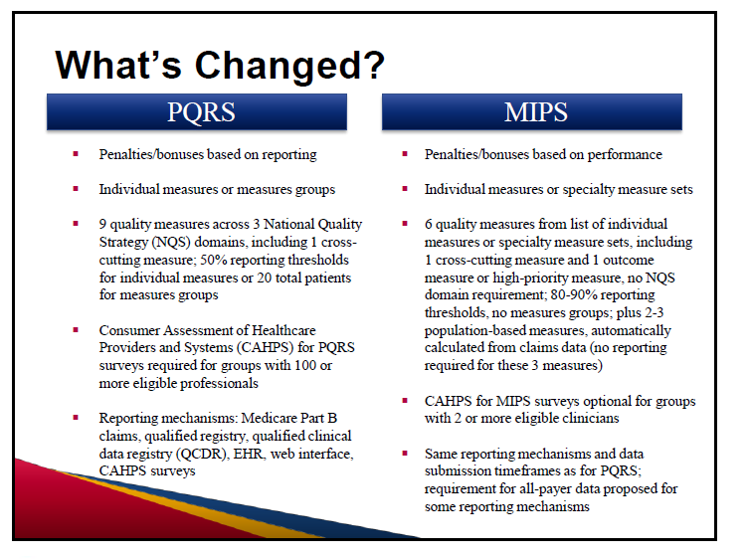

Slide 24
MIPS Proposed Rule: Measurement Categories
Quality measures fall under five quality domains:
  Clinical care
  Safety
  Care coordination
  Patient and care giver experience
  Population health and management

Slide 25
Quality Reporting Domain: Scoring Highlights
Based Upon “Performance” to national benchmarks
Score on each measure reported
Low volume thresholds
Score based on “decile” basis
Bonus Points

Slide 26
MIPS Proposed Rule:
Clinical Process Improvement Activities (CPIA) Domain Defined
Activity | Total Activities | High Weight | Med. Weight | Comment on High
Expanded Practice Access | 4 | 1 | 3 | 24/7 Practice Access
Population Management | 16 | 4 | 12 | Anticoagulation Program, for ex
Care Coordination | 14 | 1 | 13 | In CMS TCPI demonstration
Beneficiary Engagement | 24 | 1 | 23 | Patient Survey, follow up and improvement plan
Patient Safety & Practice Assessment | 21 | 1 | 20 | Prescription Drug Monitoring
Achieving Health Equity | 5 | 1 | 4 | Seeing new Medicaid Patients
Emergency Response & Preparedness | 3 | 0 | 3
Integrated Behavioral & Mental Health | 8 | 2 | 6 | Integrated behavioral health for dementia, chronic condition etc.
What does this table tell us if anything?

Slide 27
Care Coordination – Some Common Features per AHRQ
Examples of broad care coordination approaches include:
  Teamwork
  Care management
  Medication management
  Health information technology
  Patient-centered medical home
Examples of specific care coordination activities include:
  Establishing accountability and agreeing on responsibility
  Communicating/sharing knowledge
  Helping with transitions of care
  Assessing patient needs and goals
  Creating a proactive care plan
  Monitoring and follow-up, including responding to changes in patients' needs
  Supporting patients' self-management goals
  Linking to community resources
  Working to align resources with patient and population needs

Slide 28
Am I ready for MIPS or non-risk ACO? Must Have’s
Physician Practices
Physician led
Productivity
Financial
Stable core
Provider compensation methodology
Use EMR and PMS data to drive results
Growth strategy
Practice Quality Reporting
PQRS
Meaningful Use
VBM aware
Internal reporting to provider level
Use data for quality, continuity, access, satisfaction improvement
Practice IT Systems
EMR-PMS certified- updated
Physicians actively using and improving systems and reports
Single data view- interoperable
Provider level data
Clinical Practice Improvement
Physician led
Access
Population Management
Care Coordination
Patient engagement
Safety
Telemedicine

Slide 29
Have Systems, Analytics, and Reporting for Risk Contract Support
Basic functions | Examples
Unified EHR and business systems | Single platform or information exchange capability; single view data to provider level
Business analytics | Claims data request and management
Reporting – structured and ad hoc | Data warehouse; clinical quality data aggregation; cost and quality dashboards; resource utilization
Registries-clinical analytics | Population and condition; standard risk adjustment methodology
Clinical Integration | Single view clinical data
Patient Access | View EMR; eRx; requests

Slide 30
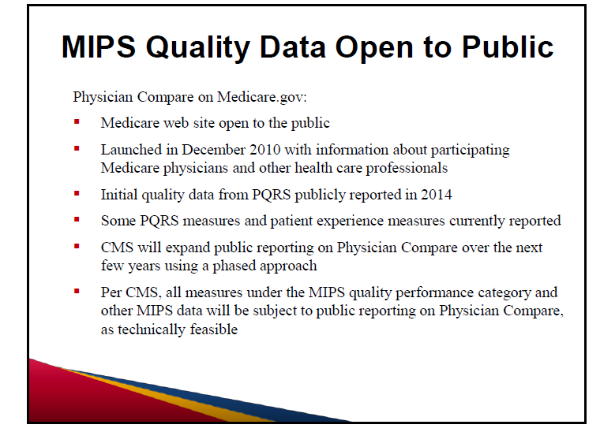

Slide 31
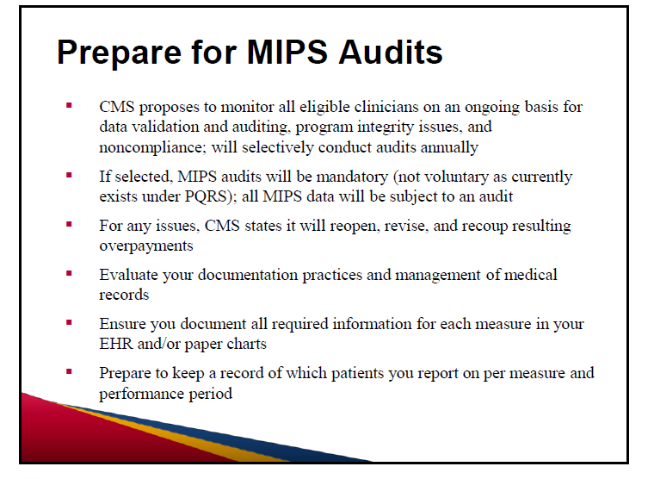

Slide 32
A practical way to think of compliance with MIPS
If you have a CHERT certified EHR updated to 2015, you should have the capability for MIPS reporting; some specialty components may not be available
If you have been doing and are up to date with PQRS reporting on all your EC’s, you should be ready for MIPS Quality reporting
If you have been participating in an ACO, check to see if you already have a path to MIPS
If you have been doing and are up to date with Meaningful Use reporting and attestations, you should ready for MIPS Advancing Care Information
Resource utilization requires no additional filing besides claims filing
Clinical Practice Improvement activities are new but should fit with your Quality practice improvement program

Slide 33
What do I do if I’m not ready for MIPS?
If you think you may be exempt from MIPS, make sure before you blow it off
If you are not doing PQRS, sign up immediately and start becoming familiar with reporting methods
If you have been participating in PQRS and VM programs look at your reports
(QRUR – Quality and resource use report and PQRS feedback report)
If you are not reporting, choose a reporting mechanism
Contact your EHR vendor to understand their capability and plans for compliance

Slide 34
MACRA resources:
▪ Centers for Medicare & Medicaid Service (CMS) Medicare Access and CHIP Reauthorization Act (MACRA) proposed rule (pdf)
▪ CMS MACRA web site
▪ CMS Resources: Fact sheets, webinars, slide decks, and more
▪ Texas Medical Association MACRA resource center
▪ American Medical Association MACRA resource center
▪ National medical specialty societies list with MACRA information
▪ Signup for CMS MACRA Quality Payment Program email updates
▪ CMS Physician Quality Reporting System (PQRS) feedback reports
▪ CMS Value-Based Payment Modifier Program quality and resource use reports (QRURs)

