Slide 1
Machine Learning at the Point-of-Care: Reclaiming Lost Opportunities for Value
John W. Cromwell, MD, FACS, FASCRS
Associate Chief Medical Officer
Director of Surgical Quality & Safety
Director of Gastrointestinal, Minimally Invasive, and Bariatric Surgery
Faculty, Interdisciplinary Program in Informatics
Professor of Surgery
University of Iowa Carver College of Medicine

Slide 2
Disclosures
DASH Analytics LLC: Co-Founder & Chief Technology Officer
Entac Medical Inc.: Co-Founder & Chief Medical Officer

Slide 3
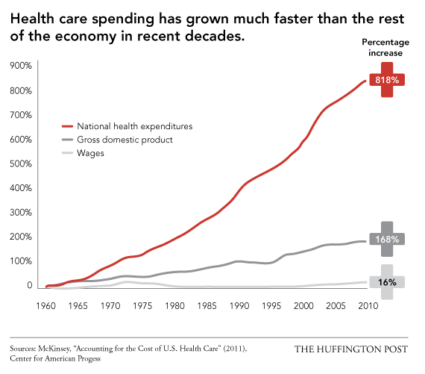
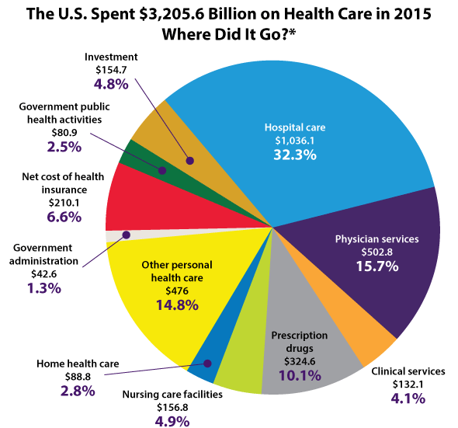
Cost of Healthcare Delivery

Slide 4
Hospital Care is the most expensive to provide
Delivery
Blood transfusions
Intensive care utilization
Surgical treatment
Technology
Adverse Events
Hospital acquired infections
Delirium
Sepsis
Falls

Slide 5
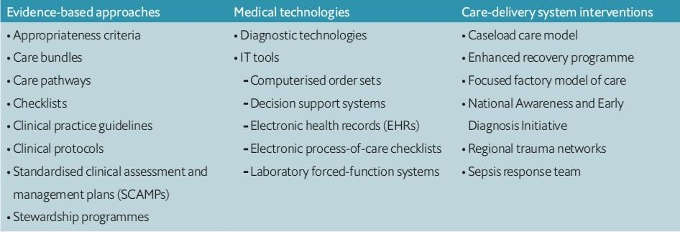
Methods to achieve high value care?
“Reducing unwarranted variation in healthcare: Does identifying and putting in place processes to reduce variation lead to better quality of care?” The Economist 2018

Slide 6
Standardization of Care Example
Virtually all patients get IV antibiotics to prevent surgical site infection
Even in the highest risk procedures, SSI rarely exceed 15%
80% of patients get antibiotics that they don’t benefit from
Downsides?
Antibiotic resistance
C Difficile
Allergic reactions
Why do we do this?
No practical and systematic way to predict which patients will benefit
Would every clinician use the information in the same way?

Slide 7
Gaps for Risk-Based Standardization
Clinicians are historically poor at risk assessment, especially using high-dimensional data
Heuristic risk assessment
Antibiotic example: Procedure, immunocompromise, implantation
When risk is identified, there is rarely clinician agreement on the best way to mitigate risk
Bias
Environment-of-care
Execution
Knowledge of local outcomes
If risk and mitigation strategy are identified, will the clinician execute

Slide 8
Gap in Clinician Risk Assessment
Good machine learning models of patient readmission (AUC near 0.70) use up to 4000 dimensions of data.
Allaudeen, N., Schnipper, J. L., Orav, E. J., Wachter, R. M., & Vidyarthi, A. R. (2011). Inability of providers to predict unplanned readmissions. Journal of General Internal Medicine, 26(7), 771–776.

Slide 9
Gap in Ability to Execute
Pre-op Visit
Day of Surgery
Post-Op
Discharge
NPO?
ICU Placement?
IV Antibiotics?
Antimicrobial Sutures?
Preoperative Education?
Wound protector?
Time to post-op visit?
Epidural Catheter?
Drain Placement?
Bowel Preparation?
Type of wound closure?
Bladder catheter?
Active Warming?

Slide 10
Thoracic epidural analgesia is recommended for open colorectal surgery.
(Level of Evidence: 1B)
Carmichael, Joseph C., et al. "Diseases of the Colon & Rectum 60.8 (2017): 761-784.

Slide 11
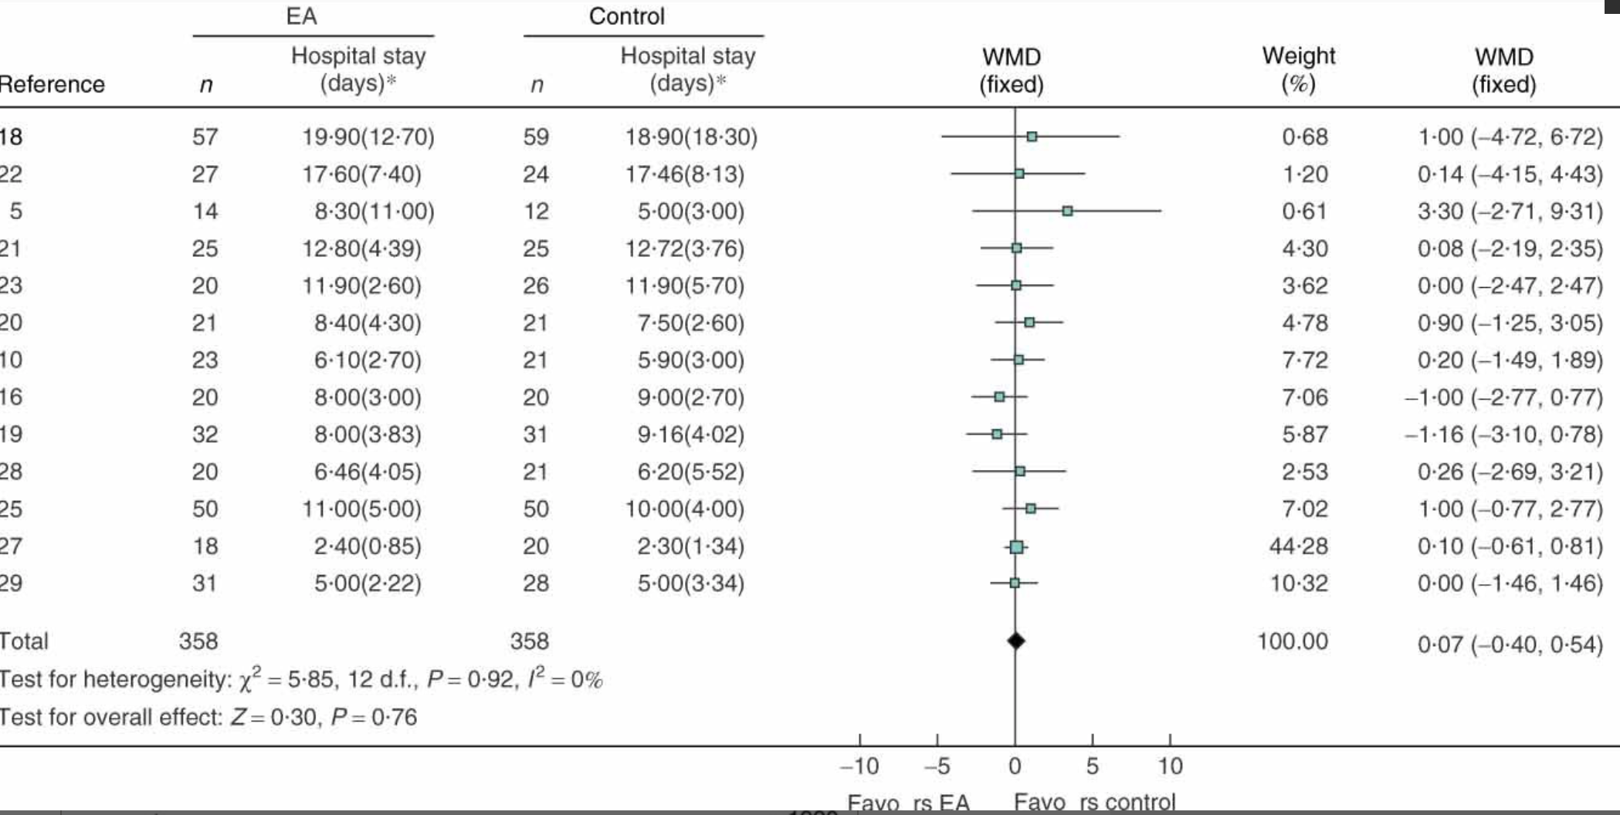
Marret, E., C. Remy, and F. Bonnet. "Meta‐analysis of epidural analgesia versus parenteral opioid analgesia after colorectal surgery." British Journal of Surgery: Incorporating European Journal of Surgery and Swiss Surgery 94.6 (2007): 665-673.

Slide 12
Gap in effectively using decision support
Knowledge and Training
Cognitive bias
Resources
Teamwork & Communication
Financial Incentives
Clinician Factors
Environment Factors

Slide 13
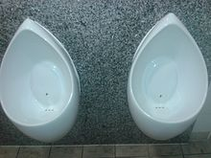
Behavioral Economics (Nudge Theory) - Mitigating Bias
Study of maladaptive behaviors
Proposes methods of reframing critical decisions to make the best decisions
These nudges are generally small and “inexpensive” changes in the environment

Slide 14
Risk-Based Standardization Goals
Standardization should be based upon:
Risk
Demonstrated local effectiveness
Standardization should mitigate
Deficits in knowledge and training
Cognitive Bias
Deficits in communication and teamwork

Slide 15
Hypothesis
Systematic application of
Real-time machine learning: What adverse event is THIS patient at risk of?
Decision intelligence: What can I do to prevent this risk that works in my environment of care?
Behavioral economics (nudge theory): Convince front-line provider not to opt out (make the right thing easy to do)
will allow us to improve patient outcomes and costs of care

Slide 16
Three Examples in Practice
Surgical site infections
Delirium
Sepsis

Slide 17
Surgical Site Infection

Slide 18
Assessing risk in surgical site infections
Medication effects
Low core temperature
Prior history of MRSA
Break in technique
+22 more variables
Surgeon identity
Age
Anemia
Blood loss
Antibiotic re-dosing
Preop Visit
Surgery
SSI

Slide 19
Assessing risk in surgical site infections
Preoperative Risk Factors
Medication effects
Low core temperature
Prior history of MRSA
Break in technique
+22 more variables
Surgeon identity
Age
Anemia
Blood loss
Antibiotic re-dosing
Preop Visit
Surgery
SSI

Slide 20
Assessing risk in surgical site infections
Intraoperative Risk Factors
Medication effects
Low core temperature
Prior history of MRSA
Break in technique
+22 more variables
Surgeon identity
Age
Anemia
Blood loss
Antibiotic re-dosing
Preop Visit
Surgery
SSI

Slide 21
Opportunities for risk-based standardization
Pre-op Visit
Day of Surgery
Post-Op
Discharge
NPO?
ICU Placement?
IV Antibiotics?
Antimicrobial Sutures?
Preoperative Education?
Wound protector?
Time to post-op visit?
Epidural Catheter?
Drain Placement?
Bowel Preparation?
Type of wound closure?
Bladder catheter?
Active Warming?

Slide 22
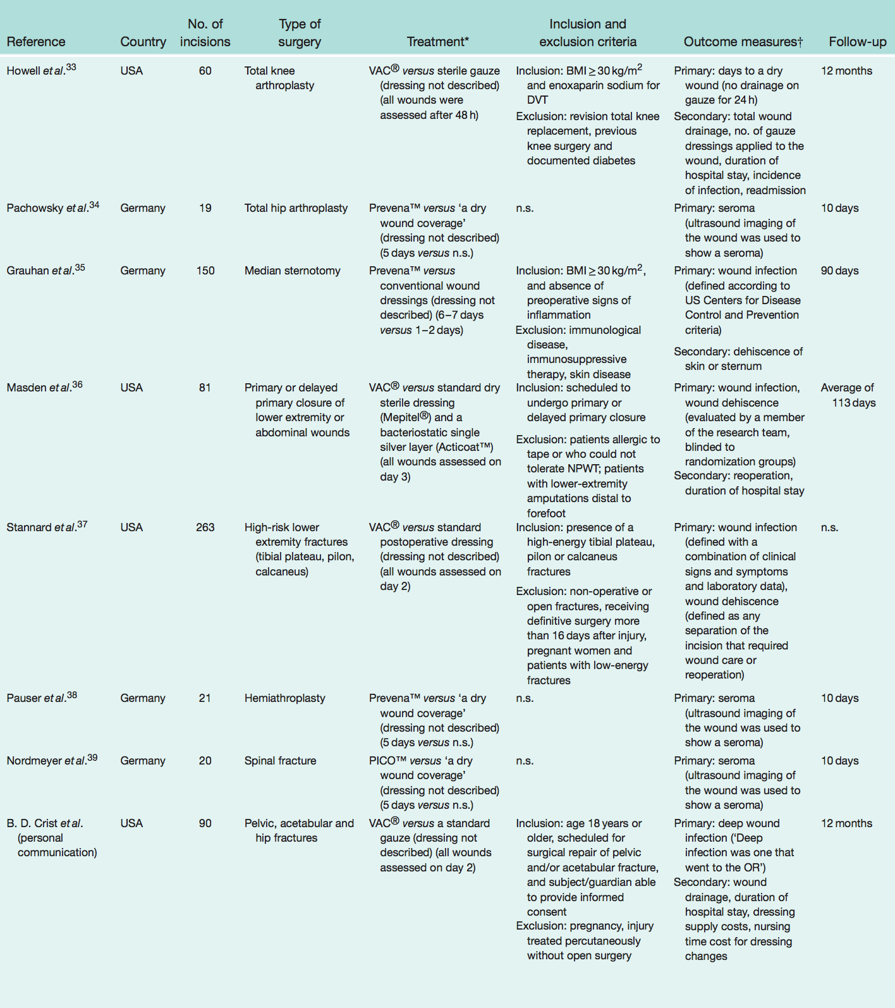
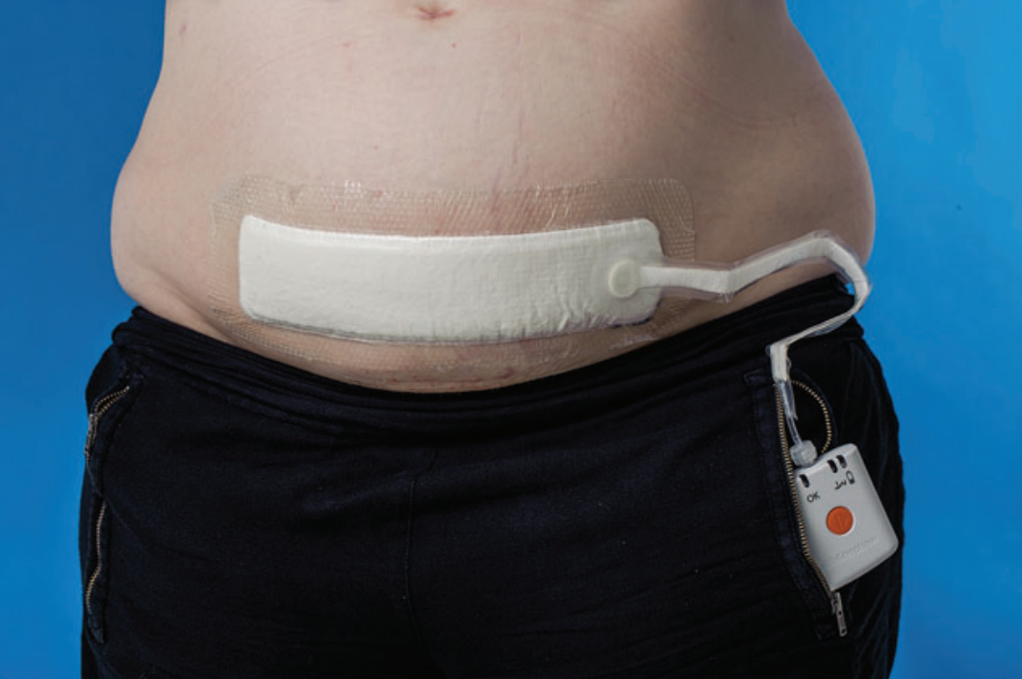
Wound Closure & Management

Slide 23
Method
Real-time machine learning risk assessment: Can we stratify risk of SSI in real time?
Decision intelligence: Can we determine a risk threshold to recommend NPWT?
Behavioral economics (nudge theory): Can we convince surgeons to use the intervention without a mandate?

Slide 24
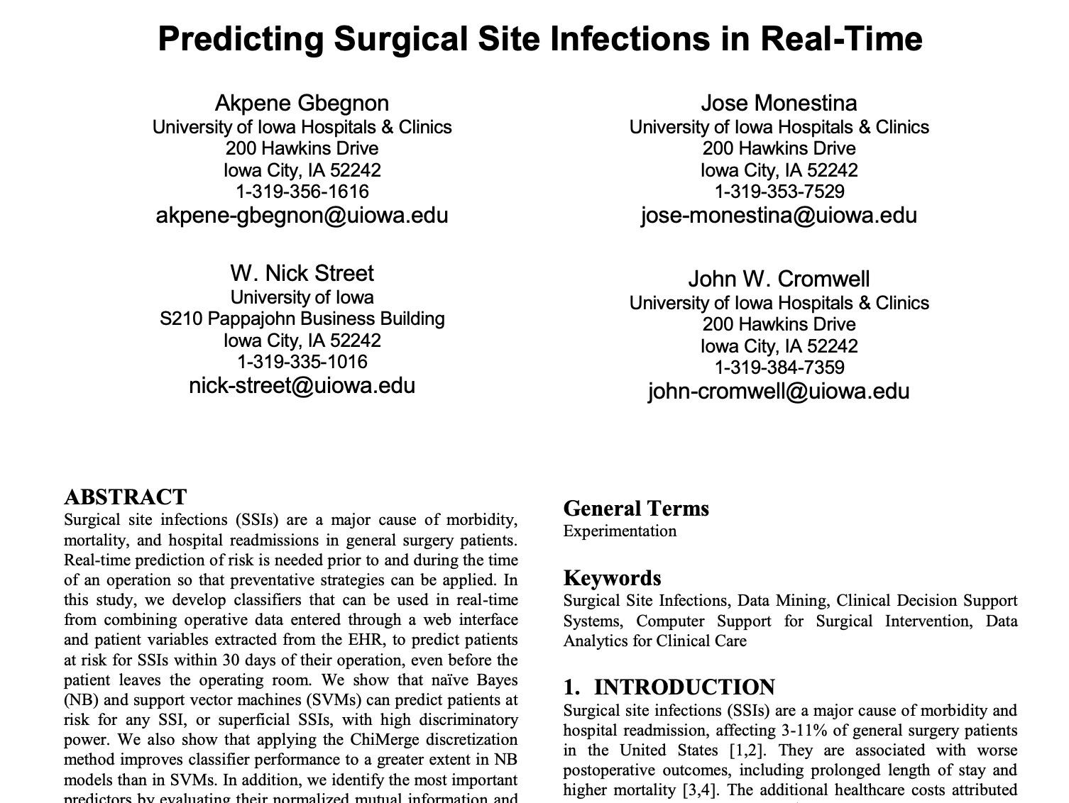
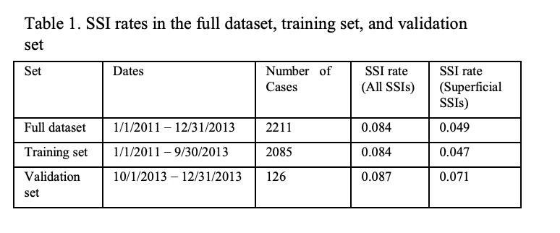

Slide 25
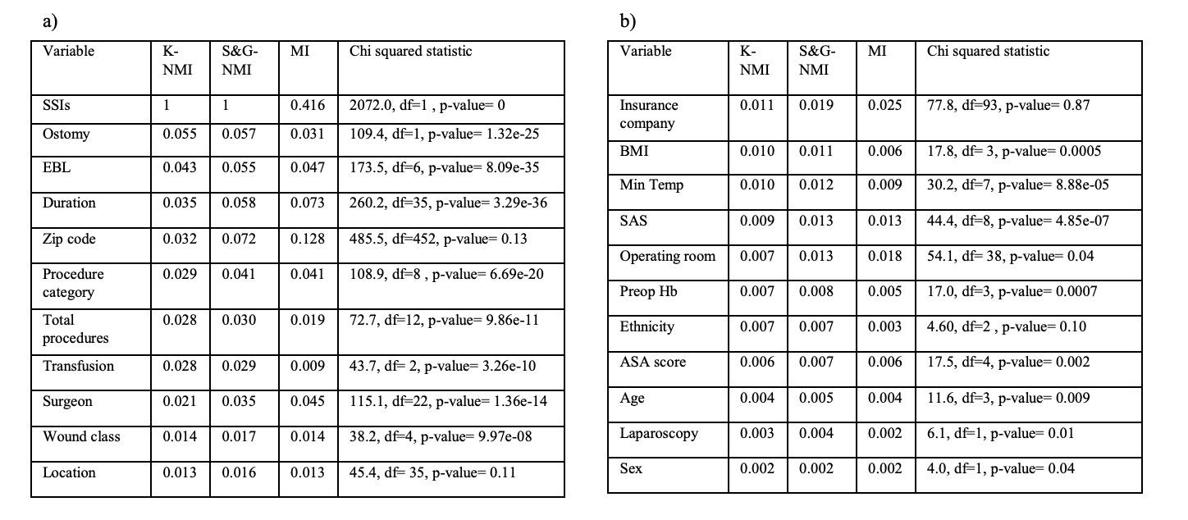

Slide 26
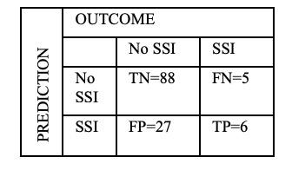

Slide 27
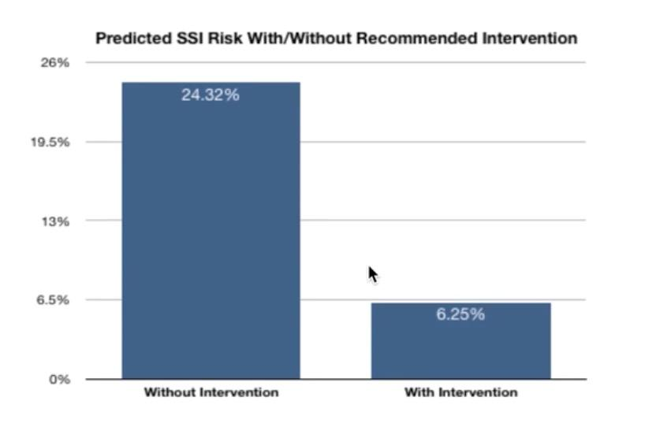
The Behavioral Economics Nudge

Slide 28
Outcomes
74% Reduction in SSI using platform
Estimated direct cost reduction of $1.2 million for every 300 patients undergoing surgery

Slide 29
Delirium

Slide 30
Delirium
Delirium is a dangerous state of confusion affecting 20-50% of the 18 million hospitalized patients in the US every year.
Delirium leads to longer length of stay (7.8 days), inpatient falls, high discharge rate to extended care and high mortality (22-76%). Systematically applied delirium treatment bundles decrease LOS by mean of 4 days
It is massively undetected with only 2% of patients being coded for reimbursement.
Inouye, S.K., Delirium in older persons. N Engl J Med, 2006. 354(11): p. 1157-65.
McCusker, J., et al., Does delirium increase hospital stay? J Am Geriatr Soc, 2003. 51(11): p. 1539-46.
The Advisory Board, Better delirium screening offers significant LOS and cost opportunity. January 2016.

Slide 31
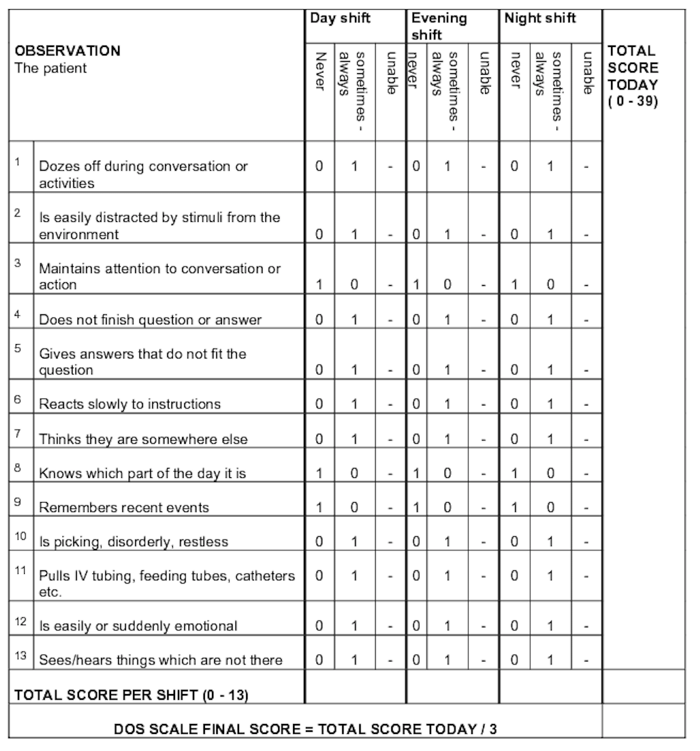
Problems with delirium care
Current manual delirium screening methods are costly, time-consuming, and have very poor sensitivity (as low at 0.13).
There is a lack of systematic application of highly effective delirium prevention/treatment bundles when risk is recognized.
There is inconsistent documentation of delirium, when present, resulting in staggering amounts of lost reimbursement.

Slide 32
Method
Real-time machine learning risk assessment: Can we stratify risk of delirium in real time?
Decision intelligence: Can we develop a threshold for which patients nursing should focus on and launch a delirium protocol?
Behavioral economics (nudge theory): Can we drive clinicians to document the presence of delirium?

Slide 33
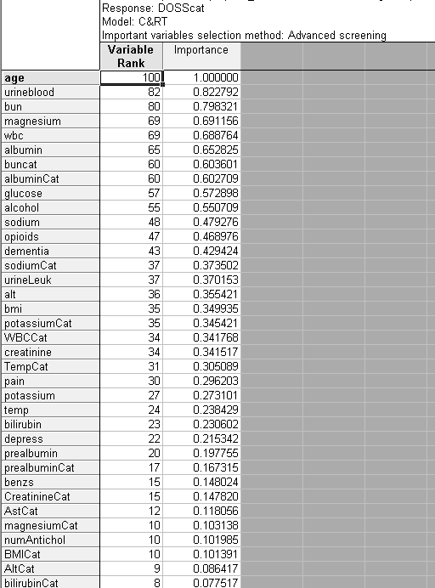
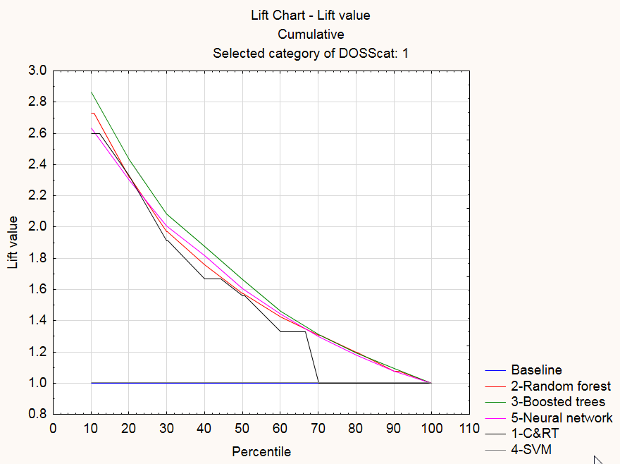

Slide 34
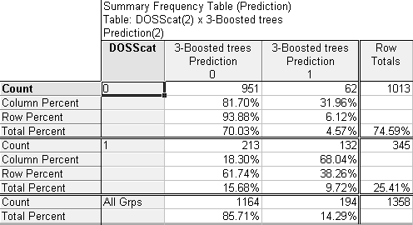
Delirium Model Validation

Slide 35
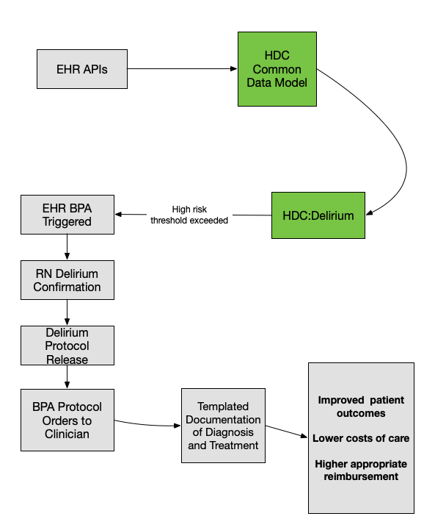
HDC Delirium Workflow

Slide 36
Potential Results
Increase delirium detection from 21% of actual delirium cases to 38% of actual delirium cases through automation
Systematically apply protocolized delirium treatment bundles in all positive-screened patients
Systematic documentation of delirium presence and treatment method to allow appropriate capture of diagnosis

Slide 37
True Delirium Rate Assumption | Per Encounter Mean Additional Reimbursement ($) | Total Additional Reimbursement ($) | Total Cost Savings | Total Increased Cash Flow
10% | $5,000.00 | $436,301.63 | $2,626,535.81 | $3,062,837.44
 | $7,500.00 | $654,452.44 | $2,626,535.81 | $3,280,988.26
 | $10,000.00 | $872,603.26 | $2,626,535.81 | $3,499,139.07
20% | $5,000.00 | $1,555,023.76 | $9,361,243.02 | $10,916,266.78
 | $7,500.00 | $2,332,535.64 | $9,361,243.02 | $11,693,778.66
 | $10,000.00 | $3,110,047.52 | $9,361,243.02 | $12,471,290.54
30% | $5,000.00 | $2,673,745.89 | $16,095,950.23 | $18,769,696.12
 | $7,500.00 | $4,010,618.83 | $16,095,950.23 | $20,106,569.06
 | $10,000.00 | $5,347,491.77 | $16,095,950.23 | $21,443,442.01
40% | $5,000.00 | $3,792,468.01 | $22,830,657.44 | $26,623,125.46
 | $7,500.00 | $5,688,702.02 | $22,830,657.44 | $28,519,359.46
 | $10,000.00 | $7,584,936.03 | $22,830,657.44 | $30,415,593.47
* In a systematic review of 42 studies on delirium, no hospital had a delirium occurrence rate under 11%. Typical rates were 20-30%.
Siddiqi et al.. "Occurrence and outcome of delirium in medical in-patients: a systematic literature review." Age and ageing 35.4 (2006): 350-364.
Most likely true delirium rate*

Slide 38
Sepsis

Slide 39
Problems with sepsis care
High mortality (17% of in-hospital deaths)
Most patients developing sepsis in rural or community hospitals will require transfer to tertiary referral center
Delayed recognition increases mortality
Any delay in care of transfer increases mortality
Transferred patients are less likely to have appropriate sepsis bundles
Mohr, N. M., Harland, K. K., Shane, D. M., Ahmed, A., Fuller, B. M., & Torner, J. C. (2016). Inter-hospital transfer is associated with increased mortality and costs in severe sepsis and septic shock: An instrumental variables approach. Journal of Critical Care, 36, 187–194.

Slide 40
Early sepsis identification
Early use of sepsis bundles
Enforcement of time-sensitive cares
Early escalation of care
Rural or Critical Access Hospital
Tertiary Referral Hospital
High Definition Care Platform

Slide 41
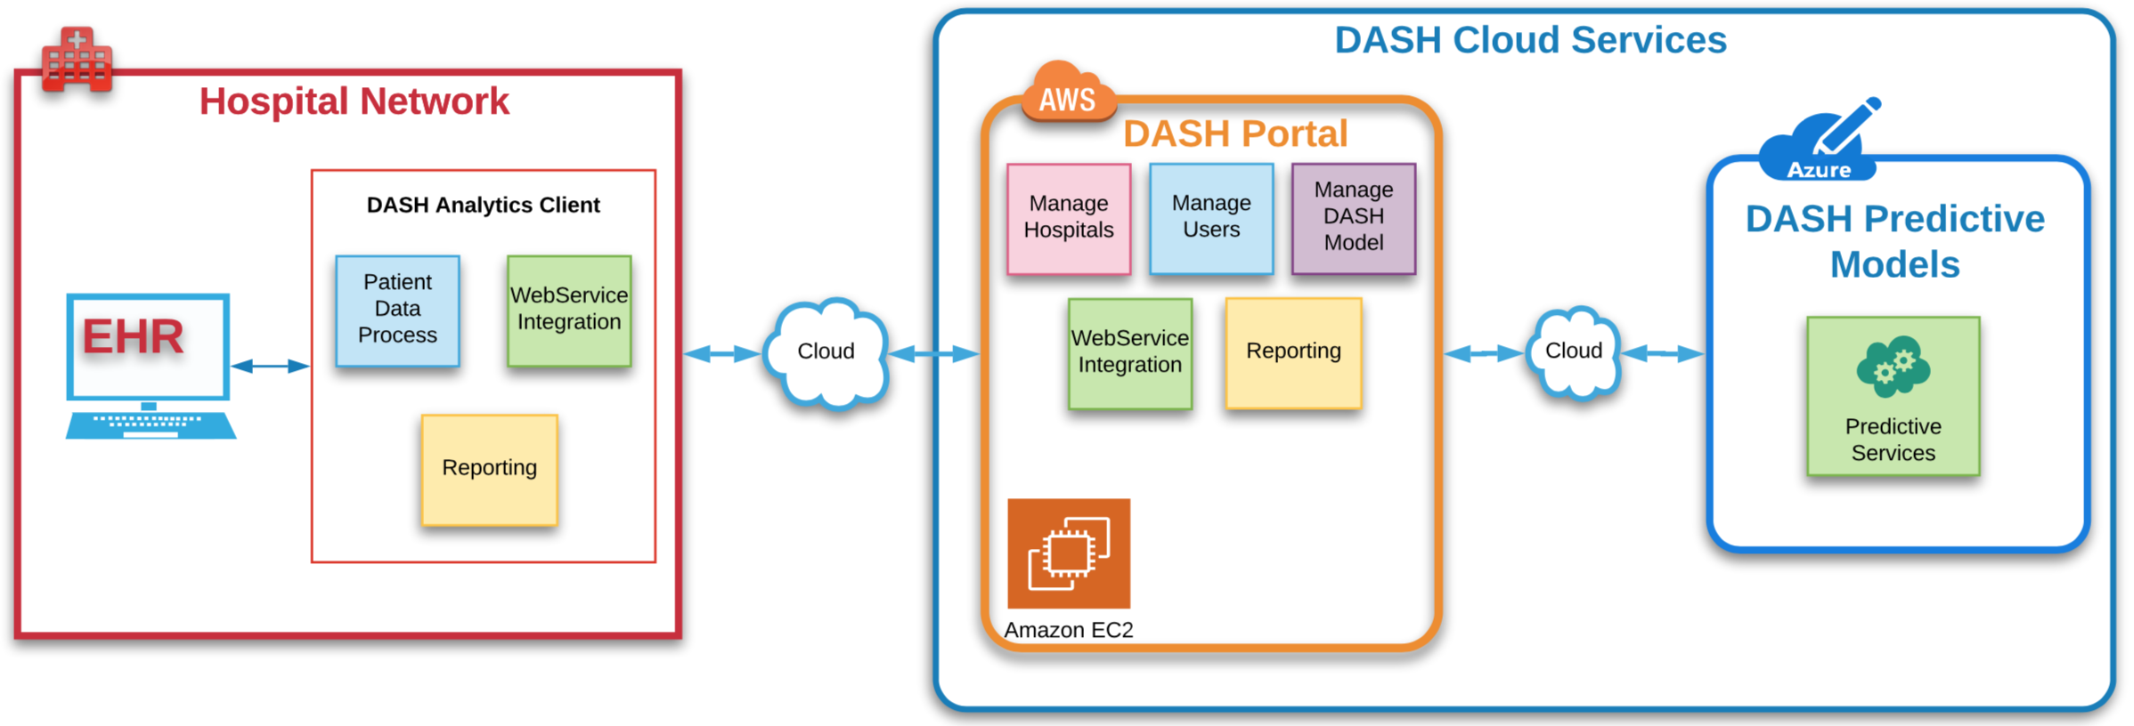
HDC Platform Architecture

Slide 42
Advantages of Multi-tenant Cloud Platform
Accelerated and shared learning: value of achieved in one system may be easily shared with others, reducing the 17-year timeline for best-practice adoption
Infrastructure for competencies necessary for ACO and other collaboratives

Slide 43
Summary
We have demonstrated that machine learning coupled with decision intelligence and nudges improves outcomes
There is potential to markedly change the dynamics and quality of hospital care delivery
Centrally managed platform can accelerate high-value care adoption and provide infrastructure for necessary competencies of ACOs

Slide 44
THANK YOU!

