Slide 1
HIMSS Maryland Chapter
Telehealth During COVID and Beyond
#Telehealth #COVID19
Presented by:
Alex Nason, Frederick Health
Dania O’Connor, Psychiatric Institute of Washington
Chris Panagiatopoulos, LifeBridge Health
Thursday October 22, 2020
12:00 pm – 1:15pm

Slide 2
President’s Welcome: We’ve Pivoted to Virtual … It’s Great to See You Again! Kathryn Whitmore
Actionable Outcomes for YOU from our Calendar of Virtual Events
Monthly Exploration of Key Challenges: VALUE for You NOW!
Join Us: Nov 20 - The New Normal in Data Sharing: Information Blocking
Follow Us: md.himsschapter.org and @MDHIMSS
Health IT Scholarship Award will be Announced Soon
Help Us? Support the Unique Needs of our Maryland Membership
Seeking Committee Volunteers with a Passion to Serve
Continuing our Charitable Support of the Community
Thank You! to All who make Our Service to YOU Possible …
Recognize the Efforts of our Board of Directors and Committee Volunteers
Special Thanks to our Generous Sponsors who help us Serve YOU!

Slide 3
A Special Thank You to our Sponsors!!!

Slide 4
IT Resilience
Protect | Transform | Innovate
Russ Barker, Enterprise Account Manager
Notes:
Today we are here to discuss a key component of business transformation- the evolution of BCDR to IT Resilience. IT resilience is the ability to innovate without disruption to the business. We shall discuss how our customers leverage Zerto to Protect, Transform and Innovate their business.

Slide 5
Telehealth during COVID-19 and beyond….
Ransomware……..”Computer systems for UHS ( 400 facilities ) began to fail over the weekend, with some hospitals forced to return to documenting patient information with pen and paper, according to reporting by NBC News, which called it "potentially the largest in U.S. history.“ - Healthcare IT News - Oct 2020
Digital Transformation…… “Healthcare needs to accelerate its transformation into digital, real time business that will bring sweeping change to the way healthcare is delivered” - Gartner – Dec 2019
Healthcare demands IT Resilience…..
1 – Always on experience
2 – Move your data …. Where you want to … when you want to…

Slide 6
Zerto Platform……Healthcare IT Resilience
Analytics & Control
Visibility Across All Sites – Proactive Compliance / Audit Trial
Orchestration & Automation
RTO ( Recovery Time ) in Minutes, RESTful API
Multi-Cloud
Replicate One-to-Many
Workload Mobility
Burst — Scale / Migrate — Failback
Non-Disruptive
Compliance Reporting
Continuous Data Protection
RPO ( Recovery Point ) in Seconds
Always-On Replication
Hypervisor — Near-sync – Scale Out
Journal-Based Recovery
Point-in-time recovery: Granular
Application Consistency Grouping
Multi-VM consistency — Multi-SLA
Long-Term Retention
Multiple copies for compliance and recovery
Notes:
How do we do it? What’s “Under the hood”? [This slide gets read from the bottom up]
First – we our software is a platform built on any infrastructure – we support all of those (point to logos) and, even better, we work between those different solutions, so you are free to use any infrastructure with Zerto.
Second – We started with the best replication engine in the market today, VM level replication with the lowest RTO / RTOs in the business.
VM-level replication has two critical features:
CDP – journal – this is like a TIVO for your TV – allows you to recover at any point in time [insert ransomware example if you like]
This enables recovery from short term logical failures and long-term recovery needs
Long-term retention
We have built one tool for all recovery needs – allows you to test recovery of applications
Important for you to mobilize and check it works and is protected
The building block for the future of resilience because all data protection will shift (and is shifting) to this use case.
This retention can and is happening in the public cloud – portability is key, so you can recover those copies anywhere
Those features of VM-level replication, function in three critical ways to make Zerto the simplest platform in the market today:
We operate at the Workload level
Virtual Protection Groups mean we have full consistency between applications
SLAs for different workloads help manage your business needs
We enable Testing with no impact on Production environment
Spin a full copy of workload and test if it’s working, test patching, dev on it with NO production disruption
We make sure impact on your Network is minimal
Included are Networking support, bandwidth acceleration…
There are two pillars that bookend the platform, without which you could not have simplicity and visibility
Orchestration is automated. Nothing manual:
This enables you to manage lots of workloads at scale
This also means that you can recover from any point in time, as an APPLICATION
It’s repetitive and predictable every time you clock button, the same thing will happen
APIs for integrating your tools on top of the platform
Analytics to see and know it’s all working. Across all infrastructures.
Like one of our customers says “I check the Zerto status with my morning coffee – when I see all green, I know the day is going to go ok”
So you see, Zerto is one SIMPLE platform for all of your IT Resilience needs
Business Continuity
Data and Application Mobility
Cloud Agility

Slide 7
Alex Nason, Director of IT Innovation, Frederick Health
Alex has more than 30 years of healthcare industry experience in research, policy, clinical, academic and consulting environments. He is a healthcare executive with a passion in innovative approaches to care delivery within a complex healthcare system. Alex has championed the development of innovative clinical services utilizing telehealth and digital technologies for over 20 years. Today, Alex is helping Frederick Health chart its own course in innovation by directing a team that is implementing digital solutions across the enterprise. Prior to joining Frederick Health, Alex has worked at Johns Hopkins Health System, the National Institutes of Health and The White House.

Slide 8
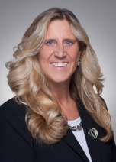
Dania O’Connor, MSSW - CEO Psychiatric Institute of Washington
Dania O’Connor has been in the field of Behavioral Health and Substance Use Disorders over 35 years. She is dedicated to implementing innovative comprehensive specialty programs to enhance recovery times. As a leader in healthcare delivery with a laser focus on integrating the state of the science and advances in technology to assess and delivery quality care. Dania’s leadership has positioned PIW as a center of innovation in a rapidly changing healthcare market. She embraces change as an opportunity to challenge the status quo while instilling Service Excellence in her team. PIW established the Partners In Care Network of community provides to address the gaps care coordination and persistent disparities in addiction and mental healthcare outcomes. The Partners In Care Network’s Referral Management System secure bi-directional referral management system supports our community based Providers and Payers with real time electronic care coordination and referral tracking.

Slide 9
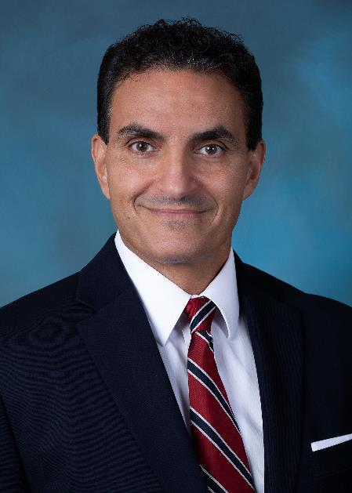
Chris Panagiotopoulos, Chief Technology Officer LifeBridge Health
LifeBridge Health is a regional health system consisting of 13,000 care bravely associates across Sinai Hospital of Baltimore, Northwest Hospital, Carroll Hospital, Levindale Hebrew Geriatric Center and Hospital, Grace Medical Center (formally Bon Secours Hospital of Baltimore), LifeBridge Health & Fitness, hundreds of primary care and specialty physicians and many affiliated health-related partners. He is responsible for the organization’s strategic development and implementation of Technology, TeleHealth, Telecommunication and Patient Call Center needs.
Chris led the technical and operational launch of the LifeBridge Health TeleHealth program in 2016. Since then, the program has expanded throughout the system supporting 70,000 annual virtual patient encounters.
Chris is a Maryland Chapter of Health Information Systems Society (MDHIMSS) past President and past Chair of the associations Advocacy Committee, educating legislators in Annapolis and Washington DC on healthcare IT issues and legislation. He received his BS in Chemistry and Masters in Engineering from Loyola University of Baltimore Maryland.

Slide 10
Frederick Health
Digital / Telehealth
Response to COVID-19
Alex Nason, Director of IT Innovation

Slide 11
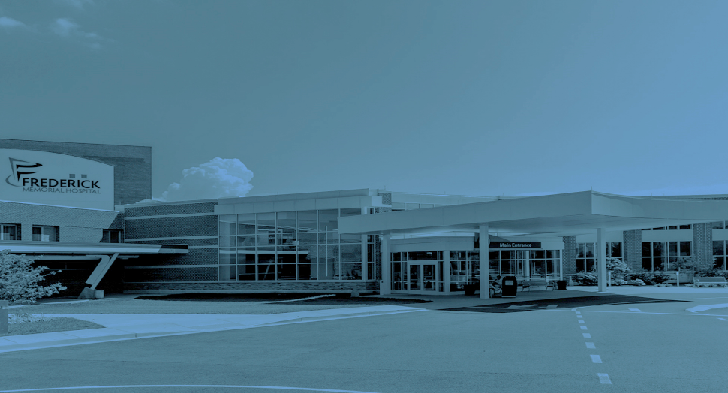
Frederick Health
Founded in 1902
Single Hospital Health System
269 licensed beds
Made up of the Frederick Health Medical Group, Frederick Health Home Care, Frederick Health Hospice and Frederick Health Employer Solutions.
Frederick Health Medical Group is a multi-specialty practice with more than 100 providers, 17 specialties
Two urgent care locations
Frederick Health Village
3,000 employees

Slide 12
Key Element of Our Consumerism Strategy
Innovate and re-envision the care delivery system to provide patient and consumer-centric integrated care
Connect and support consumer decision-making and choice
Elevate Frederick Health as a trusted source of health information for the consumer

Slide 13
Frederick Health Initiatives (Pre-Covid)
Urgent Care Virtual Visits
Asynchronous and synchronous telemedicine platform
Low acuity conditions
Secure Texting Application
Direct and secure communications among FH providers
Remote Patient Monitoring
Approx 300 monitored patients
Reduction in hospital re-admissions and ED visits;
Chronic care management
Pediatric Tele-ECHO Program
Exams transmitted to Johns Hopkins or Children's National Medical Center for interpretation

Slide 14
Frederick Health Initiatives (Covid and Beyond)
Ambulatory Virtual Visits
Video and telephone synchronous patient consults
Language interpretation services
All ambulatory specialties
Tele-Visitation Program
Inpatient visits with family via video
Rehab ‘Coaching’ program
Pastoral support
Secure Texting Application
Direct and secure communications among FH providers and patients
Tele-Sitter Program
Focus on falls reduction, reduce sitter FTE, reduce Covid exposure and manage PPE
Remote Covid Patient Monitoring
Expansion of traditional RPM program to include monitoring of Covid+ or patients via app

Slide 15
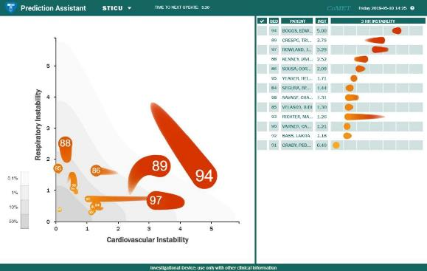
Frederick Health Initiatives (Covid and Beyond)
Covid Attestation Program
Built on Salesforce platform
Tracks all employee covid screening and self-attestation
Prediction Analytics- CoMET Program
Visualization of all patients and their risk
Long Term Care – FH Telemedicine Program
Connecting LTC providers with hospital providers for telemedicine consults to determine best course of action
Personal Health Record Connections
Apple Health connection to EMR portal for Covid test results

Slide 16
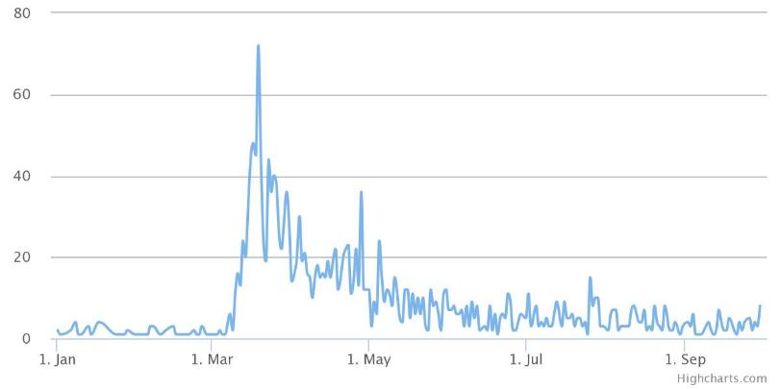
Urgent Care Virtual Visits
Daily Visit Volume
Top Protocols (excluding URI*)
*URI has attributed to 891 Virtual Visits

Slide 17
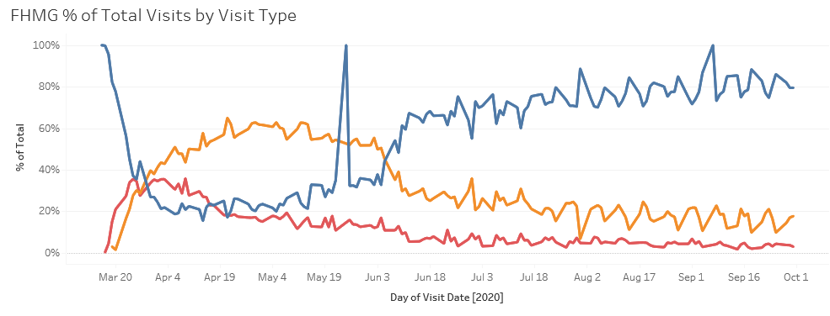
% of Total Visit Types
Today approximately 19% of all visits are telemedicine

Slide 18
What’s Next
Ongoing marketing, education and training
Expand to additional clinical areas
Embed into our clinical workflow
Integrate into our Digital Front Door strategy
Understand our patient journey

Slide 19
Working Mom Wendy
Voice of Consumer
AGE:
Consumers want an easier process for scheduling appointments online.
Consumers are unsure how a doctor can accurately diagnose ailments online.
The most frequent positive feedback has to do with the convenience aspect and the 24/7 availability of [virtual visits].
42
WHO
LOCATION:
Frederick, MD
OCCUPATION:
Broker at a local Real Estate Agency
FAMILY:
Spouse, Mother of Three
2-days ago, Wendy woke up with sinus pressure, congestion, and a sore throat
Two of her three kids were sick earlier in the week and treated successfully with antibiotics
The symptoms are worse on Day 3, but she has several appointments at work plus parent-teacher conferences for her eldest that evening
WHAT
EXAMPLE
WENDY’S HEALTH PRIORITIES, NEEDS, AND BARRIERS
My focus and energy are on my family and job; being healthy is a priority, healthcare is not necessarily a priority
It is important for me to maintain routines and avoid disruptions to daily schedules
My closest provider relationship is with my kids’ pediatrician
HOW WENDY ENGAGES IN HER HEALTH
WENDY’S SOURCES AND PATHS FOR KEEPING HERSELF AND HER FAMILY HEALTHY
HEALTH INFORMATION & ADVICE
HEALTH ACTIONS
LAST HEALTHCARE ENCOUNTER
Google (usually on her cell phone)
Tracks sleep on Apple Watch
Annual gynecologist appointment last year
Friends
Takes OTC medication for congestion
Flu shot clinic at work

Slide 20
Illustrative Digital Journey
TRIAGE/NAVIGATE
TREAT
EXPERIENCE & ENGAGEMENT
Triage/Navigate Journey
Treat Journey
Experience & Engagement Journey
Virtual Triage
1
Virtual e-Visit
Engagement
4
After a search engine directs Wendy to virtual care options on FrederickHealth.org, Wendy is prompted by a Chatbot with questions about what she is looking for and symptoms she is experiencing
After her e-visit, Frederick Health sends a text inviting Wendy to complete a net promoter survey as well as prompts Wendy with other relevant information to her diagnosis and any other health needs (hydration, nutrition, activity, etc.) that may support her recovery
(Virtual e-Visit Encounter Activities)
3
EXAMPLE
Wendy seamlessly connects to Frederick Health’s Virtual e-Visit platform through FrederickHealth.org (on her mobile device), and completes a dynamic clinical interview
In-Person Urgent Care
Combining Wendy’s responses with information from her medical record, Frederick Health’s Virtual e-Visit platform develops a potential diagnosis, order-set, and care plan, and creates an action for clinician review and validation
Based on Wendy’s responses, the Chatbot determines Wendy’s symptoms do not warrant emergent care and a virtual visit (on-demand video visit or an asynchronous e-visit) is appropriate
An available Frederick Health Provider selects Wendy’s visit and reviews/refines Wendy’s Virtual e-Visit diagnosis, order set and care plan; the system automatically documents the encounter within Meditech, and orders Wendy the appropriate prescription medication for pick-up at her local pharmacy - all within 2-4 minutes
2
Wendy is presented with the out-of-pocket cost for each option. She selects an asynchronous e-visit, due to convenience, low-cost and the ability to multitask and complete the visit at her convenience
Price Transparency
On-Demand Video Visit
Wendy receives a text message indicating the status of her visit, detailing her care plan and that her prescription can be picked up within the hour at her local pharmacy
Customer Relationship Management Platform (CRM)
‘App of Apps’ Single Enterprise-Wide Mobile Application

Slide 21
Thank You

Slide 22
Dania O’Connor, CEO, Psychiatric Institute Washington

Slide 23
Psychiatric Institute of Washington
The Psychiatric Institute of Washington (PIW) is the first and only free-standing psychiatric care facility in Washington, DC serving children, adolescents and adults for 50 years
Mission: PIW is PEOPLE with INTEGRITY and WILLINGNESS to share in the healing process and guide those we serve on the path to health.
Vision: PIW is committed to improving the behavioral health care outcomes within our community with science, innovation and Service Excellence
Services: We serve a diverse population throughout the DC Metro Area. Providing innovative inpatient behavioral healthcare (adolescents and adults), inpatient adult detox, IOP and PHP outpatient programs.

Slide 24
Partners In Care Network
PIW launched the Partners in Care Network community of Providers to improve behavioral healthcare access and respond to the opioid crisis outlined in Mayor Muriel Bowser’s Live.Long.DC Strategic Plan to Reduce Opioid Use, Misuse and Related Deaths.
Increase access to post-discharge treatment and recovery support
Enhance communications and care coordination among community stakeholders.
Foster scalable innovations, HIE technology adoption and electronic consent to share with the goal to address gaps in care coordination.
Implement eReferral Management System (eRMS) to allow the hospital and community Providers to electronically coordinate care.

Slide 25
Partners In Care Network
January 2020, just two months before the COVID epidemic, PIW launched the eReferral Management System (eRMS). The eRMS platform connects hospitals and community Providers with the capability to track and manage care coordination and referrals on discharge from PIW.
eRMS extends care beyond the hospital walls to the Medical Neighborhood.
Users communicate and exchange data electronically in a secure environment
Patients consent to share clinical data
Community Providers can track patient referrals and determine start and completion of programs.
Note: COVID accelerated the integration of telemedicine and the eRMS platform .

Slide 26
Telehealth: Expanding Access To Behavioral Healthcare And Recovery Support Services
Short History Telepsychiatry:
1959, Nebraska Psychiatric Institute used videoconferencing to provide group therapy, long-term therapy, consultation-liaison psychiatry, and medical student training
1969, Massachusetts General Hospital (MGH) provided psychiatric consultations for adults and children at a Logan International Airport health clinic.
1970s-80s expanded to most diagnostic and therapeutic interactions.
1990s,research began on its ability to facilitate access to care, overcome geographical obstacles and comparison to in-person care.
2000s, the field began to see it as effective, but slightly different, than in-person care, and research in outcome studies provided a platform for practice guidelines (e.g. the American Telemedicine Association).
Today- Telepsychiatry is equivalent to in-person care in diagnostic accuracy, treatment effectiveness, and patient satisfaction; it often saves time, money and other resources.
Patient privacy and confidentiality issues parallel in-person care
Leverages specialty expertise, which facilitates health care reform (e.g., patient-centered care and integrated care

Slide 27
Telehealth: Expanding Access To Behavioral Healthcare And Recovery Support Services
PICN Goal: Care coordination using HIE technology and telemedicine to improve post-discharge access to community Providers
Pre-COVID: Slow adoption of telemedicine among community Providers
Discharge coordination
Telemedicine
TeleMAT
COVID: Immediate adoption and implementation of telemedicine among PICN Providers
Expanded/extended PIW services via Telemedicine
TeleIOP
TelePHP
TeleConnect
TeleRecovery Support (coming soon)

Slide 28
Telehealth: Expanding Access To Behavioral Healthcare And Recovery Support Services
Challenges:
Internet Access / Bandwidth
Patient access to internet and smart devices
Stable tele-video platforms
Opportunity:
Expand Care Transitions goals of the 1115 Wavier Behavioral Health Transformation
Share best practices to reinforce adoption and build momentum
Build a connected Medical Neighborhood. Increase access to remote monitoring through smart devices/apps
Integrate telemedicine with electronic health screenings & diagnostics
TeleRecovery Support coming soon! Increase High-Tech/High-Touch, on-demand, access to mental health and addiction treatment recovery support and services.

Slide 29
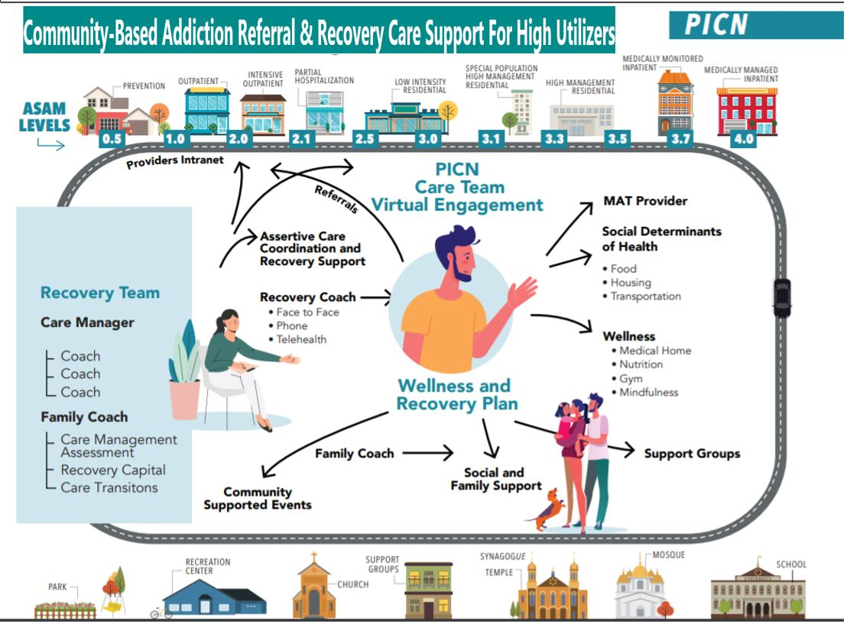

Slide 30
Thank You! | One Team – One Goal!

Slide 31
Partners In Care Network
The Referral Management System Overview

Slide 32
User Roles
1. System Manager – Hospital Representative
Confirm BAA between PIW and Community Provider
Add organization’s users and roles
Schedule training
Track activity by Organization and Coordinator
Reporting
Coordinator – Hospital Representative / Payer
Serves as Social Worker/Care Coordinator and Referral Coordinator
Uploads care transition documents (Care Plan, Clinical Data, Consent to Share)
Selects Service Provider based on Care Plan
Service Provider – Community Providers
Accepts/Rejects Referrals
Receives care transition documents as a PDF

Slide 33
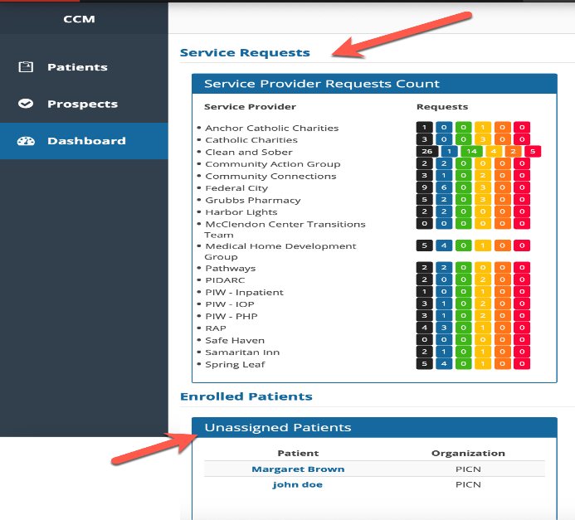
Coordinators Dashboard
Social Workers/Care Coordinators will be able to complete referrals, and manage the process, seamlessly. Patients are in the Unassigned Patients list and once assigned to a Service Provider, they appear under that Service Provider Requests Count.

Slide 34
3 Steps - Referral to Service Provider
Patient must Consent to Share clinical information with Service Provider.
Once all requirements are met, the Coordinator Approves the Patient.
Once Approved, Discharge documents are uploaded to patients account and Referral is made to the Service Provider.

Slide 35
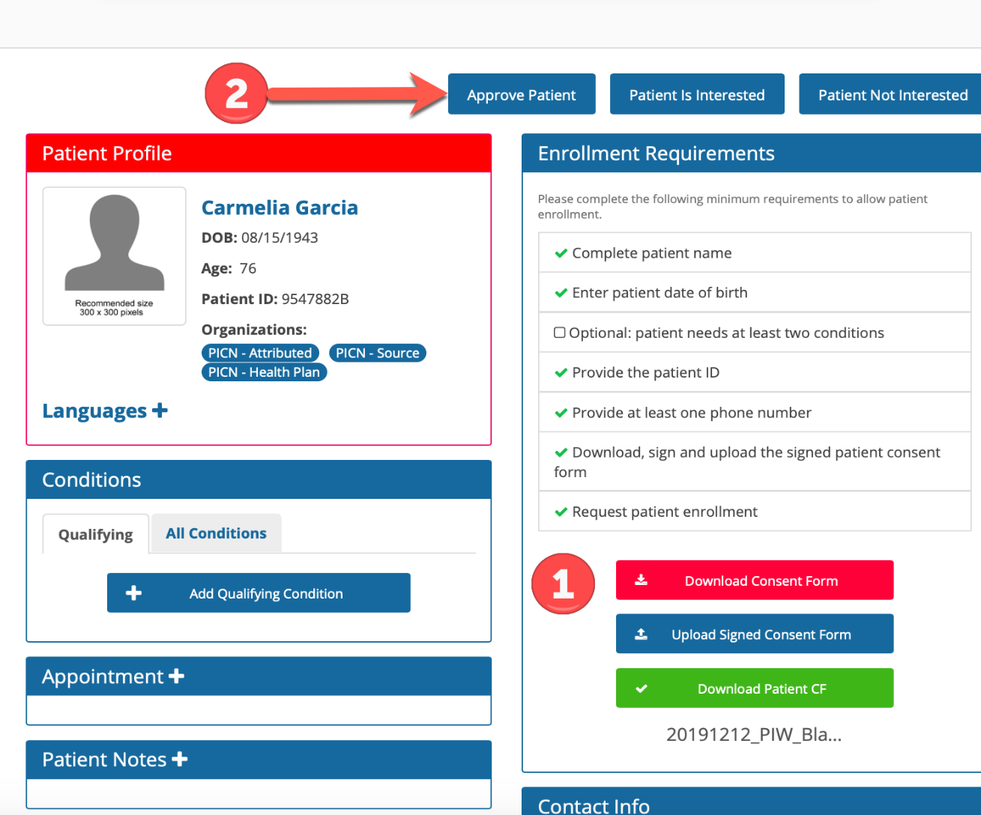

Slide 36
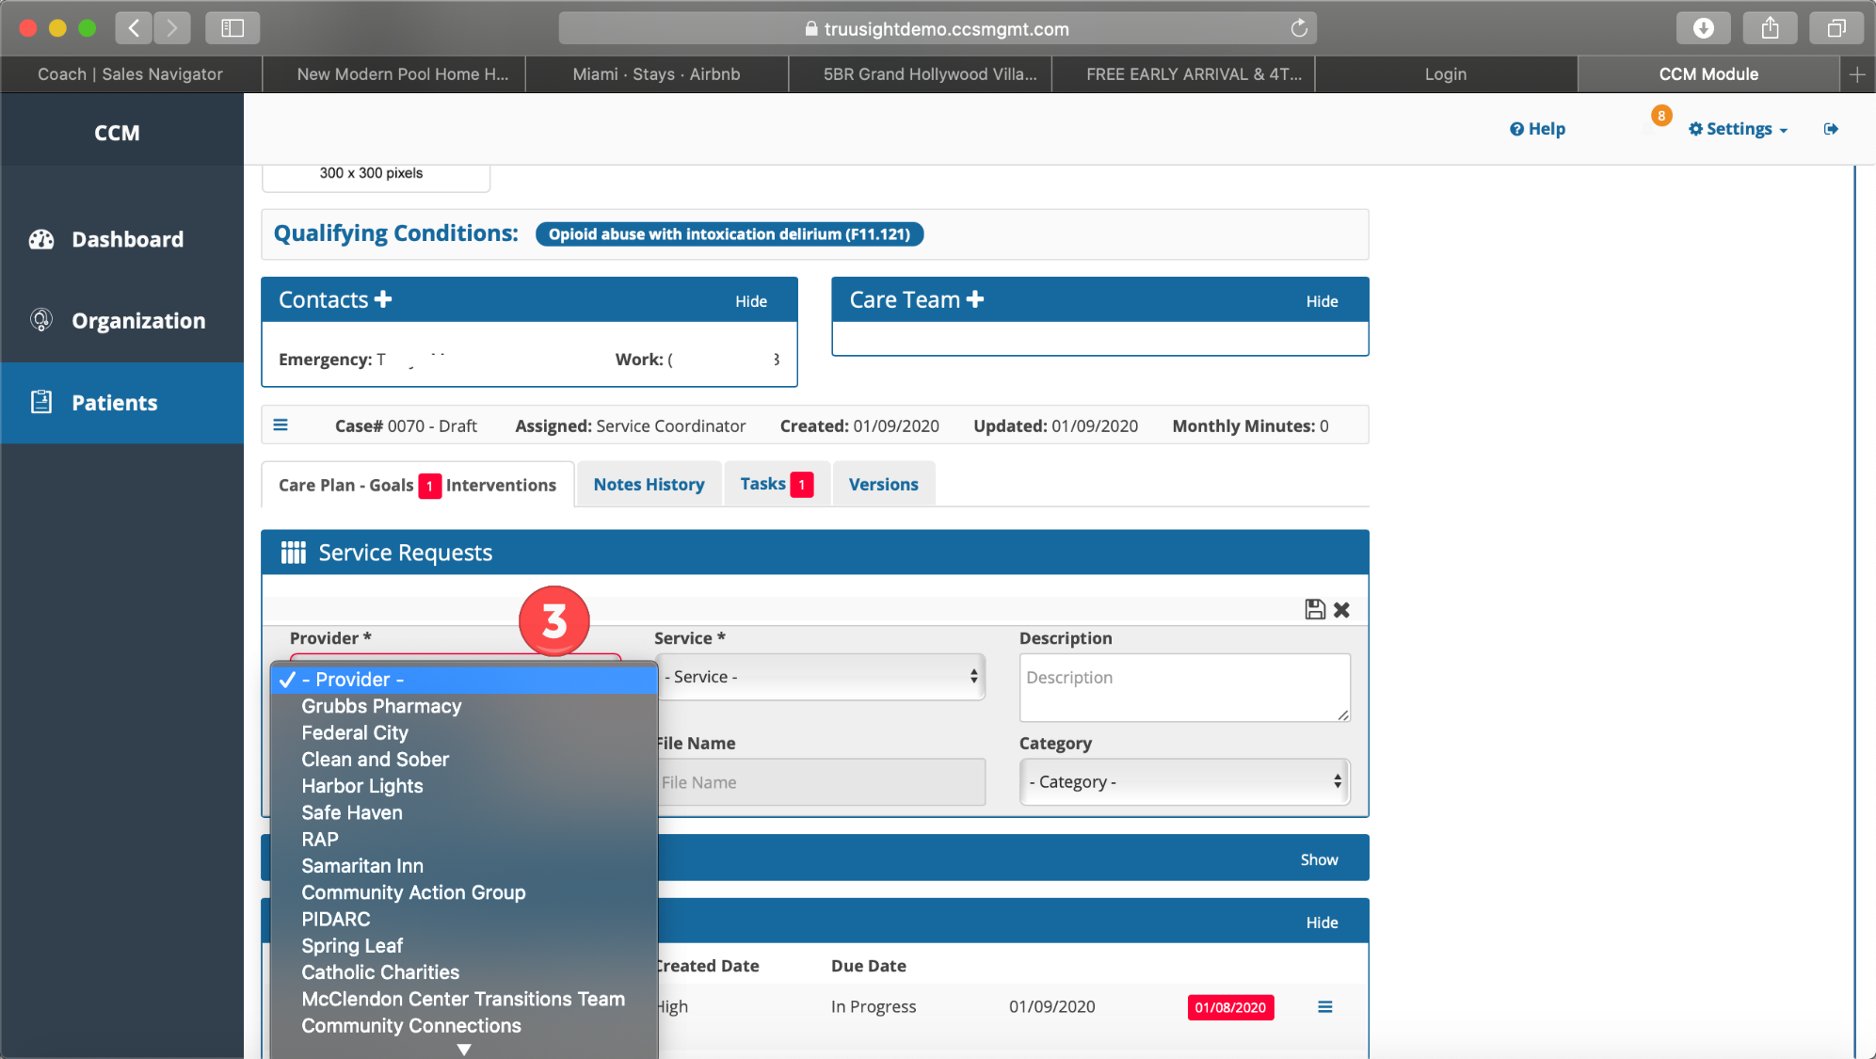

Slide 37
Service Provider View
Once the Coordinator makes the referral it immediately appears in the Referral View.
Service Provider can Accept, Reject, View Notes, and View / Download Attachments.

Slide 38
Once Service Provider Accepts referral, the patient is now a client and appears in the ”Clients” Section.

Slide 39
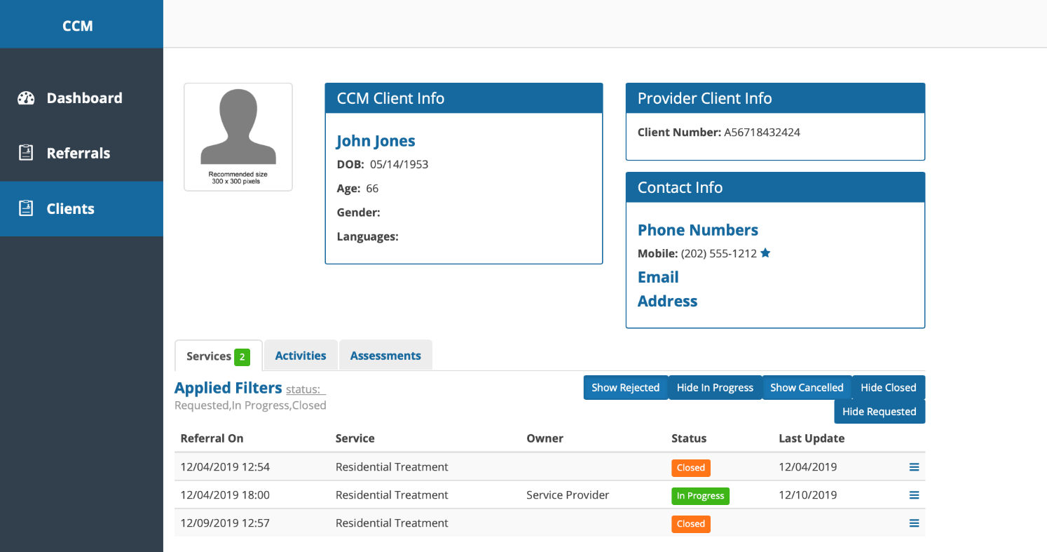
Service Providers can use the platform to manage clients and view historical information if necessary.

Slide 40
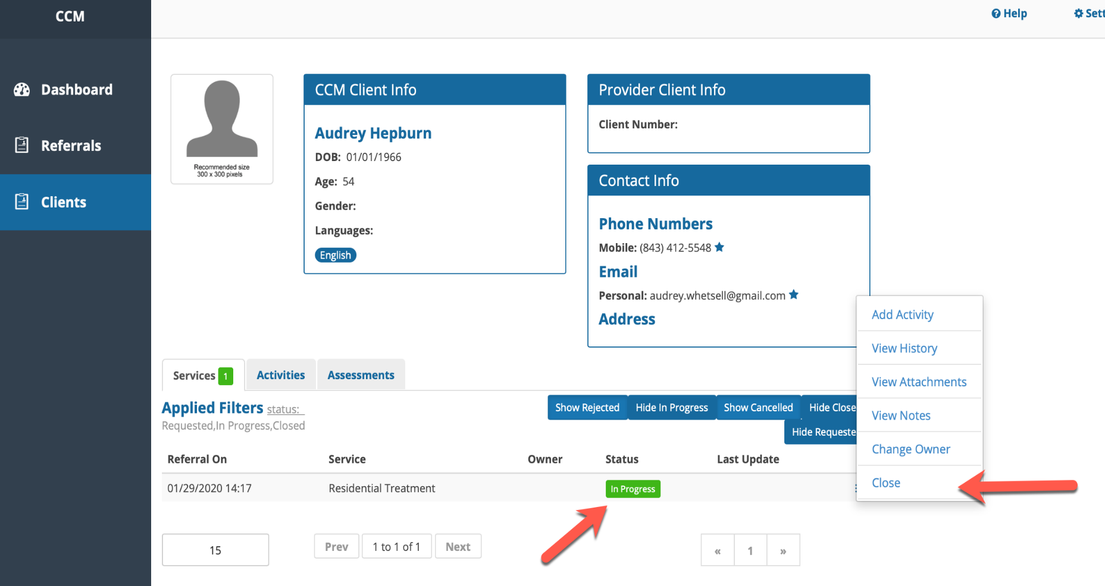

Slide 41
Telehealth During COVID-19 and Beyond
Maryland HIMSS
October 22, 2020

Slide 42
Outline
LifeBridge TeleHealth Journey
Pre – COVID Strategy
COVID Pivot
The Future of TeleHealth

Slide 43
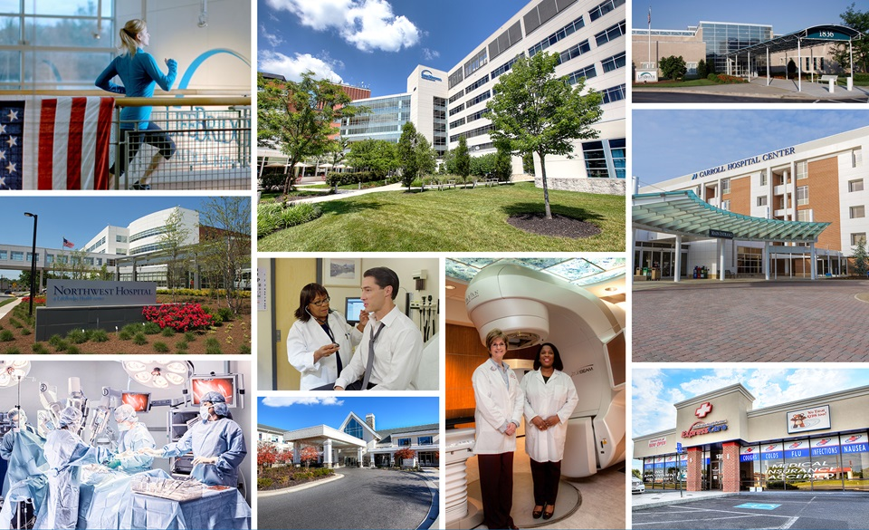
5 Hospitals
6 Nursing Homes
840 Providers
13,000+ Employees
32 Urgent Care Sites
100+ Locations
Notes:
Fourth largest health system in the state
Sixth largest private employer in Greater Baltimore area

Slide 44
LifeBridge Health: Providing the Full Continuum of Care
Ambulatory Services
Urgent Care
Transportation
Acute Care
Post-Acute Care
Senior Living
Subacute

Slide 45
LifeBridge TeleHealth Journey
2016 Program Development
2017 Establish Technology Platform & Use Cases
2018 Grow Virtual Encounters, Establish Virtual Hospital
2019 Expand Consumerism
2020 COVID Pivot

Slide 46
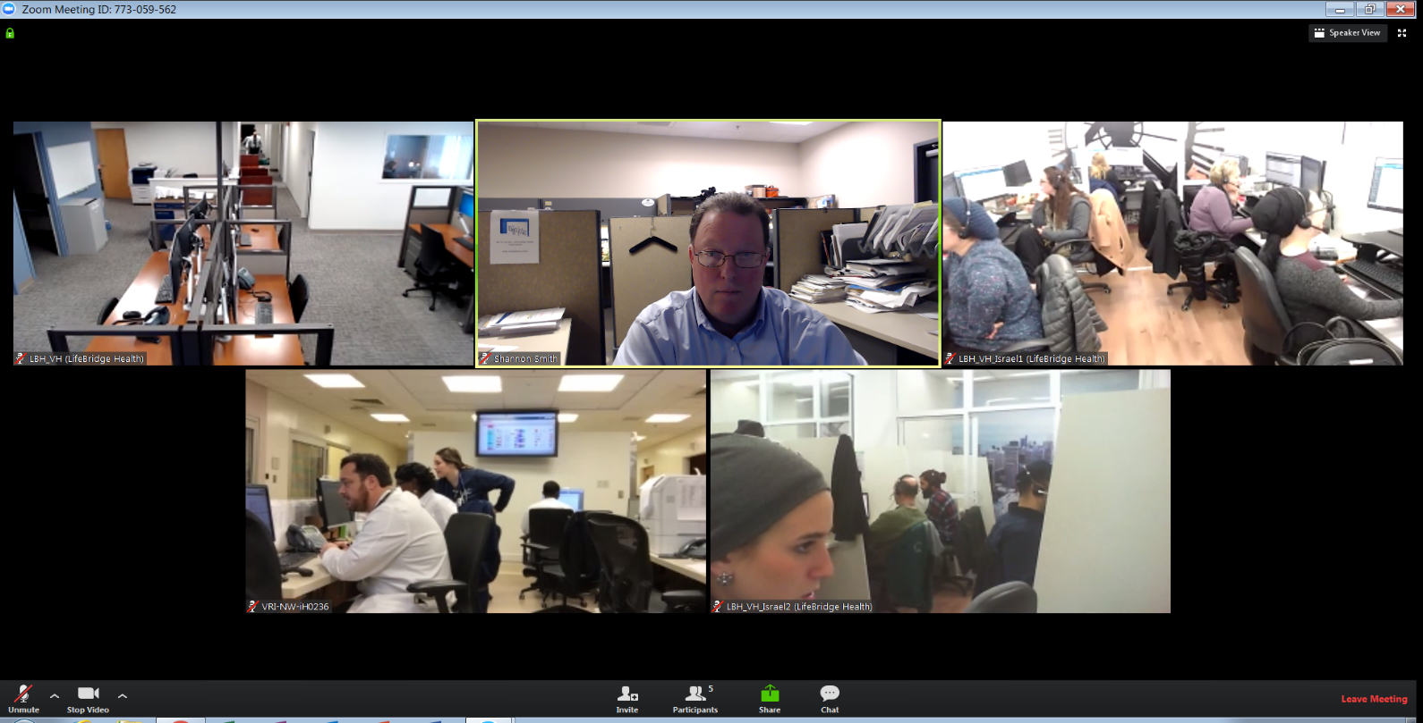
LifeBridge Virtual Hospital
Sinai Based -Virtual
Hospital
Patient Smith
Northwest
ED
Israel Call
Center

Slide 47
Virtual Use Cases (Pre-COVID)
TeleStroke
ED
Behavioral Health
TeleTriage
Ortho Consults
Remote Patient Monitoring
TeleHospitalist
TeleSitter
Pharmacy Consults
Ambulance – Virtual Consults
Primary Care Providers *
16,000
Virtual Encounters/yr.

Slide 48
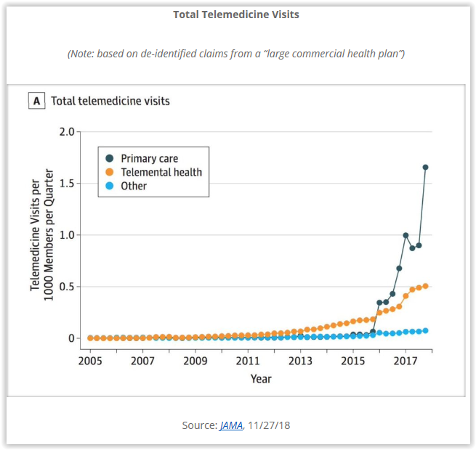
Industry Trends
Growth
Opportunity

Slide 49
COVID Pivot

Slide 50
New COVID Period Use Cases
Expand PCP and Specialty Use
COVID-19 Team Screening
ED Reg. Negative Pressure Room
ICU Support
One on One Counseling – Pop Health
Mobile Clinic
Inpatient Behavioral Health
Pastoral Care Visits

Slide 51
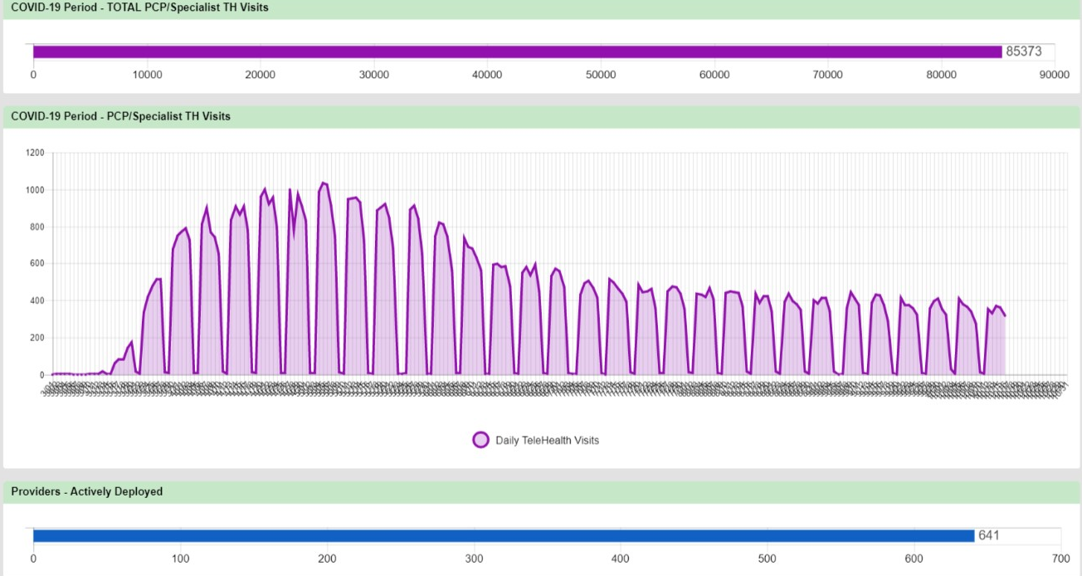
Virtual Care: From Zero to 60 in Warp-Speed
Patient Survey Rating
4.5 out of 5

Slide 52
Patient and Physician Satisfaction

Slide 53
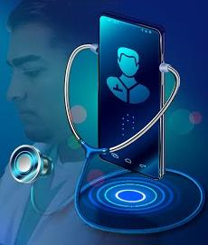
The Future of TeleHealth
Reimbursement for Telehealth
OCR relaxed HIPAA enforcement
Protections from misdiagnosis
Ability to practices across state lines
Patient compliance with visits

Slide 55
Panel Q & A

Slide 56
Door Prize Drawing
Courtesy of Zerto $100 Amazon Gift Card
You must be present to win

Slide 57
Thank you so much for your participation and generous donation to the Maryland Food Bank!
We look forward to you
participating in
upcoming virtual events:
November 20, 2020
Information Blocking – Dealing with the New Normal in Data Sharing
Speaker from the ONC
Breakout discussions for different actors
December TBD
Career Roundtable

