Slide 1
HIMSS NCA Chapter Announcements
Enabling HIT with
Value-Based Care
September 19th, 2019

Slide 2
Presidential Remarks
Chapter President Nicholas Crismali

Slide 3
Meet The HIMSS NCA Board, 2019-2020
President Nicholas Crismali
President-Elect Darryl Roberts
Treasurer Darrin Washington
Secretary Ann Kenny
Programs Chair Laura Bennett

Slide 4
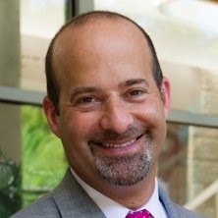
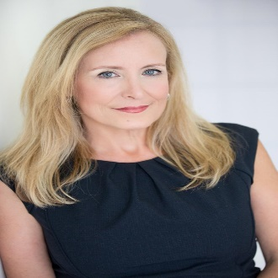
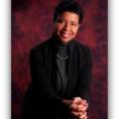
Meet The HIMSS NCA Board, 2019-2020
Advocacy & Community Dan Blum
Charity Barry Dickman
Membership William Manel
Communications Carol Miller
Sponsorship Janet Webb
Outreach & Collaborations Antoinette Williams

Slide 5
Membership at HIMSS NCA
Membership | Cost
Student Chapter | $30
Regular Chapter | $39
National (incl free chapter membership!) | $199
Additional Savings available for non-profit and corporate partnerships!
Get ahead of the game with access to insights and intelligence from government speakers and leading industry executives
Network with top contractor decision makers, movers, and shakers
Get involved with the HIMSS NCA Chapter Board and shape the future of federal health IT
Get access to webinars, policy and position papers, industry research and more for FREE from HIMSS National
Save an average of 20% on events and online content

Slide 6
Upcoming Programs and Events for 2019 - 2020
January 14 -15 2020: AFCEA Health IT Summit,
Bethesda North Marriott Hotel and Conference Center 5701 Marinelli Rd, Bethesda, MD

Slide 7
Thank You 2019-20
Corporate Chapter Sponsor

Slide 8
Thank You 2019-20 Corporate Chapter Sponsor

Slide 9
Thank You 2019 - 2020
Social Media Community Partner
11

Slide 10
HIMSS NCA Social Media
#HIMSSNCA

Slide 11
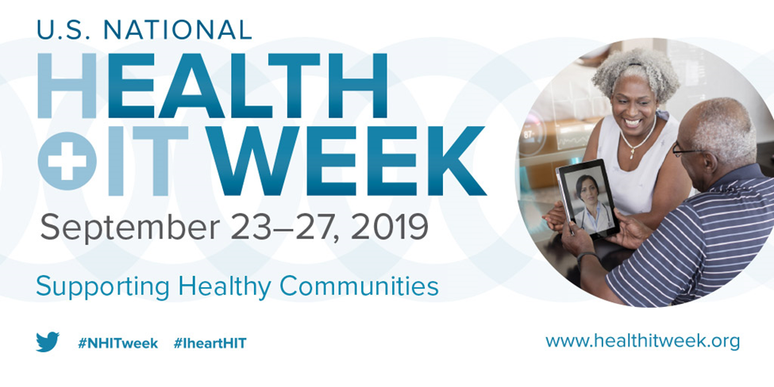
The BLUM Report- Welcome Back!
The BLUM Report- Welcome Back!
The 2019 U.S. National Health IT Week theme will focus on Supporting Healthy Communities and driving transformation of our health and wellness ecosystem by:
Advancing Public and Population Health
Modernizing Public Health Infrastructure
Accelerating Workforce Development
Expanding Access to Broadband and Telehealth
Addressing Social Determinants of Health
13

Slide 12
The BLUM Report- It’s Never Too Late
News and Announcements
2019 U.S. National Health IT Week Partners and Awards Reception – Sep 25
Rayburn House Office Building, Room 2045 Washington, DC
Our Program Tonight: Value Based Care and HIT
Outreach: Engaging our local HealthIT communities
Kickoff: NCA Mentorship and Scholarship Programs
Update: What’s going on in VA and MD
Update: The Sequoia Project Cooperative Agreement and ONC RCE award
14

Slide 13
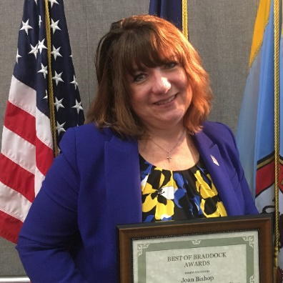
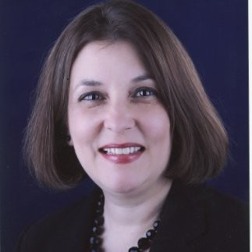
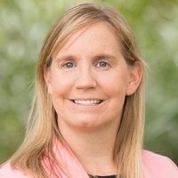
The BLUM Report- It’s Never Too Late
Introducing NCA Mentorship Chair
Ms. Joan Bishop
Introducing NCA Scholarship Chair
Ms. Maria Gaboury
Update from The Sequoia Project
Ms. Dawn Van Dyke

Slide 14
The BLUM Report- It’s Never Too Late
Upcoming Events
2019 U.S. National Health IT Week Partners and Awards Reception – Sep 25
Rayburn House Office Building, Room 2045 Washington, DC
HIMSS Maryland Chapter — Sep 26
Annual Networking Event at the Ten Oaks Ballroom, Clarksville
HIMSS Virginia Chapter — Oct 21-23
Fall meeting on Digital Health at the Kingsmill Resort, Williamsburg
BPM+ Health — 24-25 Sep
Loews Vanderbilt in Nashville, TN

Slide 15
HIMSS NCA September Program - Enabling Value-Based Care with HIT
Objectives
Tonight’s panel will discuss how CMS, VA, and DoD tap into Health IT to advance Value-Based-Care (VBC).
22
Topics of Discussion
Investment strategies for HIT systems to accelerate VBC
Integrated systems and interoperability
Current VBC impact on major health programs
VBC successes in community care and military health networks
Future of modernization and digital transformation

Slide 16
HIMSS NCA September Program - Enabling Value-Based Care with HIT
Moderator
Dan Blum, HIMSS NCA Advocacy and Community Chair
Panelists
COL Francisco Dominicci, Chief, Solutions Division J-6 Defense Health Agency (DHA)
David R. Hunt, MD, FACS, Medical Director, Patient Safety Office of the National Coordinator for Health IT (ONC)
David F. Massaro, MD, MHCDS, MBA, FAAFP, FACHE, Deputy Chief Medical Officer & Primary Care Lead, VA MidSouth Healthcare Network
Andrew Robie, MD, Chief Medical Information Officer Unity Health Care DC
Dawn Van Dyke, Head of Marketing Communications Sequoia Project

Slide 17
HIMSS NCA September Program - Enabling Value Based Care with HIT
Our health system has been challenged with managing rising healthcare costs.
Recent efforts to improve the quality of our nation’s healthcare system date from the 90’s and continues.
By 2030, Defense Health Agency estimates project costs will grow to more than five times ($95B) from the 2001 level, due to large increases in new eligible beneficiaries, expanded benefits, increased utilization, and health care inflation.
HHS/CMS/ONC are leading the way to incentives-based healthcare delivery programs - high in quality& high in value.
Promoting better clinical outcomes at lower costs.
This panel will discuss how CMS/ONC, VA, DoD and District of Columbia tap into Health IT to advance Value-Based Care (VBC).

Slide 18
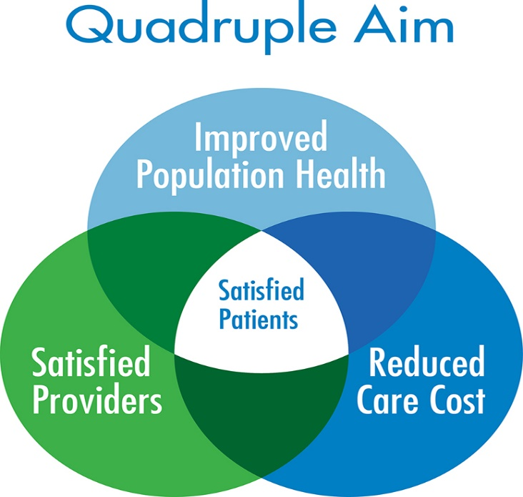
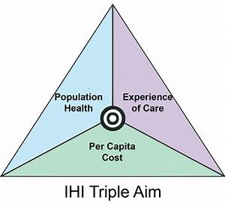
HIMSS NCA September Program - Enabling Value-Based Care with HIT

Slide 19
HIMSS NCA September Program - Enabling Value-Based Care with HIT

Slide 20
Panelists
COL Francisco Dominicci, Chief, Solutions Division, J-6, Defense Health Agency
David F. Massaro, MD, MHCDS, MBA, FAAFP, FACHE, Deputy Chief Medical Officer | Primary Care Lead, VA MidSouth Healthcare Network, Veterans Health Administration (VHA), Department of Veterans Affairs (VA)
David R. Hunt, M.D., FACS, Medical Director, Patient Safety, Office of the National Coordinator for Health IT (ONC)
Andrew Robie, MD, Chief Medical Information Officer, Unity Health Care, Washington, DC
Dawn Van Dyke, Director, Marketing, Sequoia Project-Connected we stand!

