Slide 1
Data Aggregation
The key requirement for meaningful analysis
Presented by Joe Nichols MD
Principal – Health Data Consulting

Slide 2
Aggregating Data - Impacts
Patient population research
Identifying disease focus and care priorities
Cost efficiency measures
Quality measures
Disease surveillance
Monitoring outcomes
Coverage and payment rules
Utilization measurement
Clinical and financial risk measurements
Source: Health Data Consulting Inc.

Slide 3
Aggregating Data - Challenges
Same concept in many places:
Current categorization in the ICD-10 tabular index
Condition | Tabular Category | Number of Codes
Hypertension | Hypertensive Disease | 14
 | Other Categories (14) | 115
Pneumonia | Influenza and Pneumonia | 38
 | Other Categories (18) | 42
Genitourinary Disorders | Diseases of the Genitourinary System | 587
 | Other Categories (14) | 535
Source: Health Data Consulting
Because of the ‘combination’ nature of ICD-10 codes, they may not be in the category that the user might expect
Source: Health Data Consulting Inc.

Slide 4
Finding concepts vs words
Down’s syndrome [4 codes]
Source: Health Data Consulting
Source: Health Data Consulting Inc.

Slide 5
Finding concepts vs words
Renal Failure / Kidney Failure [20 codes]
Source: Health Data Consulting
Source: Health Data Consulting Inc.

Slide 6
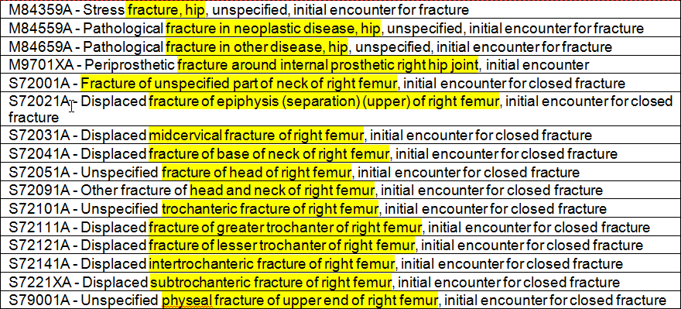
Finding concepts vs words
Hip Fracture / Proximal Femur Fracture / Fracture upper end of the femur [1,260 codes]
* 38 codes returned if “fracture” and “hip” are used in the query
Source: Health Data Consulting
Source: Health Data Consulting Inc.

Slide 7
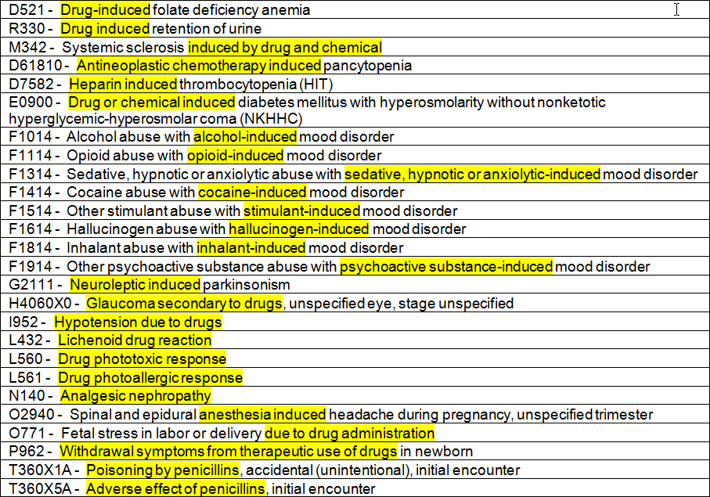
Finding concepts vs words
Drug induced [3,104 codes]
Source: Health Data Consulting
Source: Health Data Consulting Inc.

Slide 8
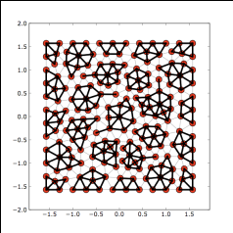
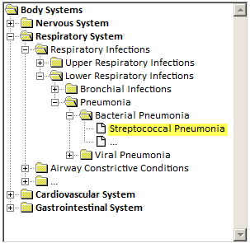
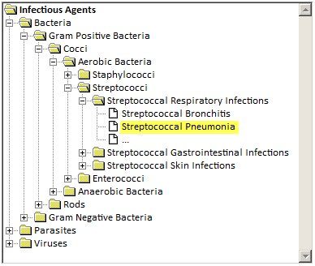
Aggregating Data - Challenges
Which Taxonomy Model?
In hierarchal categorization models (taxonomies), what is the right categorization structure?
Source: Health Data Consulting
Source: Health Data Consulting
Source: Health Data Consulting Inc.

Slide 9
Aggregating Data
Ontologies – assigning metadata
Ontologies allow for the ability to categorize based on a limitless number of concept relationships as expressed in metadata tags.
Source: Health Data Consulting
Streptococcal Pneumonia
Relationship | Ontological Concept
Is a type of | Pneumonia
Is a type of | Infection
Is a condition of | Pulmonary system
Is a condition of | Lung
Is caused by | Streptococcus
Is a | Communicable Disease
Source: Health Data Consulting
Source: Health Data Consulting Inc.

Slide 10
Analytic Comparisons
The following analytic presentations are based on:
Three years of payer data
All lines of business
Inpatient, outpatient and professional
17 Million claims
$10 Billion in charges
813,178 unique individuals
$12,200 average per person charges for all claims during the time frame
Source: Health Data Consulting Inc.

Slide 11
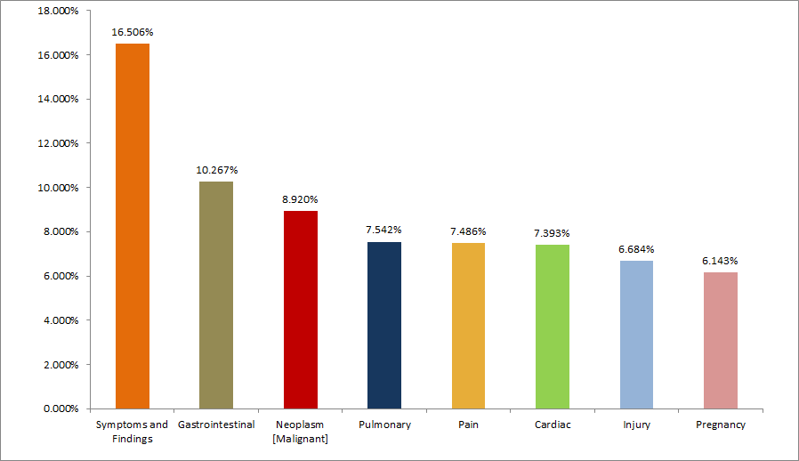
Concept Based Analysis
Common Claim Diagnosis
Source: Health Data Consulting
Source: Health Data Consulting
Source: Health Data Consulting Inc.

Slide 12
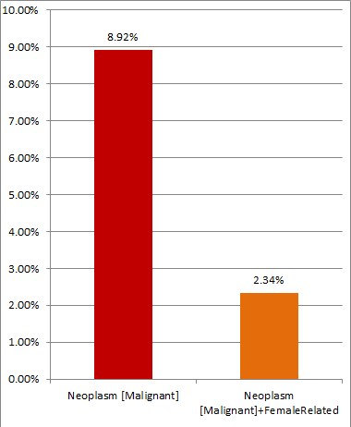
Concept Based Analysis
Neoplasms
Source: Health Data Consulting
Source: Health Data Consulting
Source: Health Data Consulting Inc.

Slide 13
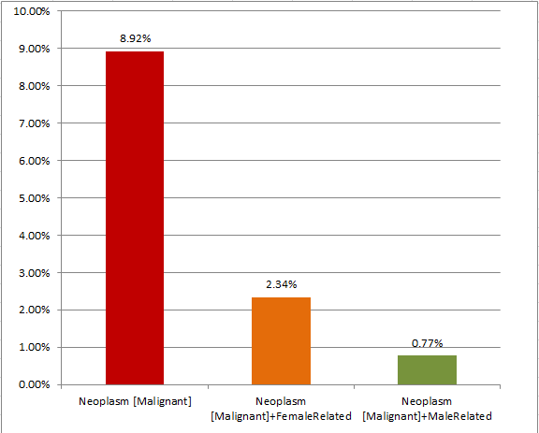
Concept Based Analysis
Neoplasms
Source: Health Data Consulting
Source: Health Data Consulting
Source: Health Data Consulting Inc.

Slide 14
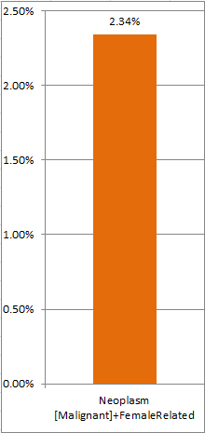
Concept Based Analysis
Neoplasms
Source: Health Data Consulting
Source: Health Data Consulting
Source: Health Data Consulting Inc.

Slide 15
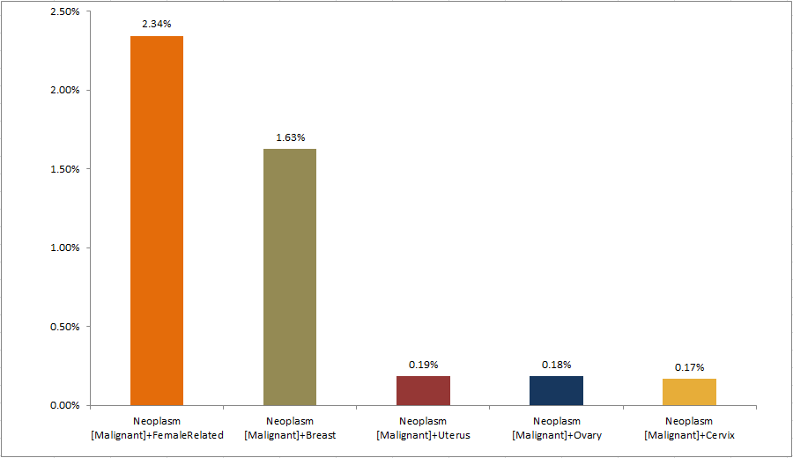
Concept Based Analysis
Neoplasms
Source: Health Data Consulting
Source: Health Data Consulting
Source: Health Data Consulting Inc.

Slide 16
Concept Based Analysis
Diabetic Retinopathy
Source: Health Data Consulting
Condition Parameter | Per person charges* | Ratio to Average**
Diabetes | $35,341 | 2.90
Diabetes + Retinopathy | $69,424 | 5.69
Diabetes + Retinopathy + Proliferative | $118,654 | 9.73
* Average total of all claim charges for a person with any claim in this diagnostic category
** Ratio of the average total of all claim charges for a person with any claim in this diagnostic category compared to the average for all persons for all claim charges ($12,200)
Source: Health Data Consulting
Source: Health Data Consulting Inc.
MDMeta © 2016

Slide 17
Concept Based Analysis
Renal Failure
Source: Health Data Consulting
Condition Parameter | Per person charges* | Ratio to Average**
Renal Failure | $233,219 | 19.12
Renal Failure + Acute | $285,238 | 23.38
Renal Failure + Chronic | $279,247 | 22.89
* Average total of all claim charges for a person with any claim in this diagnostic category
** Ratio of the average total of all claim charges for a person with any claim in this diagnostic category compared to the average for all persons for all claim charges ($12,200)
Source: Health Data Consulting
Source: Health Data Consulting Inc.
MDMeta © 2016

Slide 18
Concept Based Analysis
Cardiac Disorders
Source: Health Data Consulting
Condition Parameter | Per person charges* | Ratio to Average**
Acute Myocardial Infarction | $137,986 | 11.31
Valvular disorders | $78,299 | 6.42
Cardiac rhythm disorders | $68,222 | 5.59
Hypertension | $31,376 | 2.57
Heart failure | $144,357 | 11.83
Heart Failure + Acute | $220,275 | 18.05
Heart Failure + Chronic | $186,915 | 15.32
* Average total of all claim charges for a person with any claim in this diagnostic category
** Ratio of the average total of all claim charges for a person with any claim in this diagnostic category compared to the average for all persons for all claim charges ($12,200)
Source: Health Data Consulting
Source: Health Data Consulting Inc.
MDMeta © 2016

Slide 19
Concept Based Analysis
Malignant Neoplasm
Source: Health Data Consulting
Condition Parameter | Per person charges* | Ratio to Average**
Malignant Neoplasm | $28,062 | 2.30
Malignant Neoplasm + Breast | $68,009 | 5.57
Malignant Neoplasm + Prostate | $33,835 | 2.77
Malignant Neoplasm + Lung | $205,493 | 16.84
Malignant Neoplasm + Colon | $32,398 | 2.66
Malignant Neoplasm + Skin | $35,925 | 2.94
Malignant Neoplasm + Pancreas | $168,323 | 13.80
Leukemia | $158,090 | 12.96
Lymphoma | $147,027 | 12.05
* Average total of all claim charges for a person with any claim in this diagnostic category
** Ratio of the average total of all claim charges for a person with any claim in this diagnostic category compared to the average for all persons for all claim charges ($12,200)
Source: Health Data Consulting
Source: Health Data Consulting Inc.
MDMeta © 2016

Slide 20
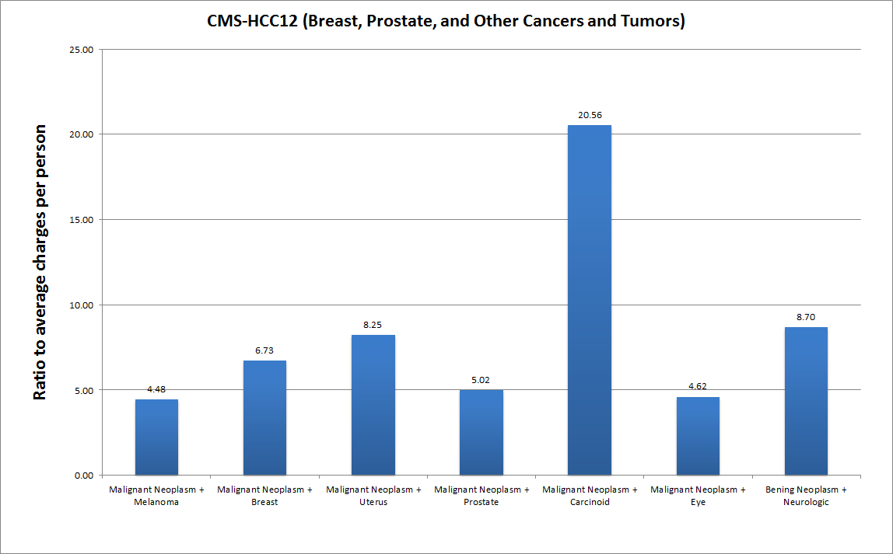
Concept Based Analysis
CMS-HCCs
Source: Health Data Consulting
Source: Health Data Consulting Inc.
MDMeta © 2016

Slide 21
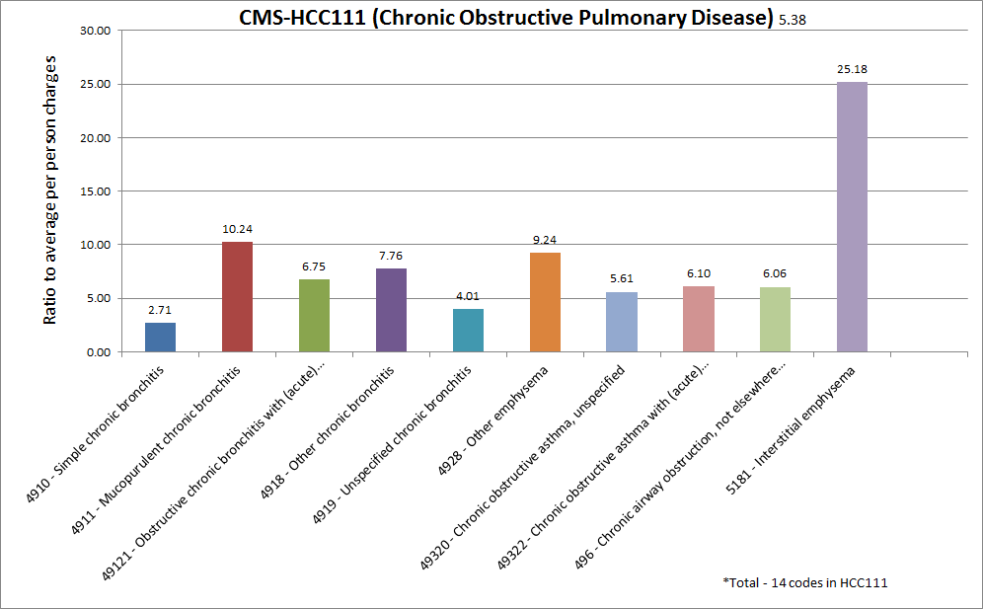
Concept Based Analysis
CMS-HCCs
Source: Health Data Consulting
Source: Health Data Consulting Inc.
MDMeta © 2016

Slide 22
Aggregating Data Limitations of current analytic tools
Most analytic tools leave it up to the user to define categorical disease parameters
Categories and hierarchal relationships when defined are static
Drill-down to details must follow a predefined path
Medical concepts cross categories and do not fit in a single hierarchal bucket
Source: Health Data Consulting Inc.

Slide 23
Aggregating Data Limitations of current analytic tools
The content of categories is defined in a black box often by persons who lack a clinical background
Information is not actionable since questions about parameters of diseases are constrained to predefined static categories
Disease parameters cannot be combined
Source: Health Data Consulting Inc.

Slide 24
Aggregating Data Requirements for meaningful categorization
Management of categorization schemes requires a data governance structure that:
Assures the right resources (clinicians, coders, billing staff, IT professionals, executive sponsorship, administrative support)
A consistent process for definition and maintenance of documentation
Ongoing review and updates of defined categories
Transparent access to the definition of all categories
Definition of the category to include
Specific description of the category
Intended purpose or use of the category in analysis
What should the category include and/or exclude?
Source: Health Data Consulting Inc.

Slide 25
Summary
Source: Health Data Consulting
Accurate complete and reproducible aggregation is the key to virtually any medical information use.
There are substantial challenges in aggregating data due to the structure and description of existing codes as well as the need for clinical knowledge.
A strong data governance process is critical
By applying clinical knowledge to metadata tagging of codes, data aggregation can be easily accomplished in a way the is accurate, consistent, complete and medically sound.
The process of aggregation can be reduced from an intensive research process that is prone to errors, to one that can be done in consistently and rapidly based on the selection of predefined concept based tags.
Source: Health Data Consulting

