Slide 1

Patient Experience: Connecting Physical and Digital Journeys
  Karen Curtis, Senior Director
  Susan Kanvik, Senior Director
  Point B
  March 29, 2018

Slide 2



Karen Curtis
Point B Senior Director, Healthcare
Karen Curtis is a Senior Director in Point B’s Healthcare Practice. Karen has over 20 years of management consulting experience in the healthcare industry, with a focus on strategic and business planning for healthcare provider organizations. She has expertise developing new care delivery models and planning and launching accountable care organizations and population health strategies. Karen holds a MBA and MHA from the University of Washington and a BS from the University of Notre Dame.
Susan Kanvik
Point B Senior Director, Healthcare
Susan is a Healthcare Senior Director for Point B and has a 40 year plus track record in healthcare operations and information technology—specializing in provider clients. Susan has helped healthcare organizations with a wide-breadth of system selections, implementations and optimizations as well as assessment and process redesign efforts. Before joining Point B, she worked at Group Health Cooperative for 16 years in a variety of leadership positions in both Health Promotion and Information Technology. Susan holds a BS in Community Health Education, cum laude, from the University of Utah, a Master of Public Health, cum laude, from the University of Illinois, and a Certificate in Information Systems Management from City University.
Point B

Slide 3

Learning Objectives
Include
    Understanding Patient Expectations
    Comprehensive Patient Experience Governance
    Focus on Operational Support for Digital Experience
    Clear understanding of the buy vs build
    Organizational Change Management Approach
Point B

Slide 4

Understanding Patient Expectations

Slide 5






Patients are consumers. How does this change “healthcare as usual”?
Deeper Consumer Relationships
Complex Affiliations
Increased Competition
Change to Business Models
Rapid Technology Change
Notes:
Consumers are adopting a consumer mindset when purchasing healthcare services.
Healthcare has evolved from the days when the local doctor, corner pharmacy and neighborhood hospital were the obvious choices for care. Patients are faced with higher deductibles and out-of-pocket expenses, and on the hook for more of their healthcare costs.
Consumers want information to make buying decisions and are looking information such as price transparency and quality measures.
As patients put on their consumer hats and purchase services directly, covering first dollar costs with high deductibles, they are expecting the same level of service they would receive in other consumer-based environments.
Given this paradigm shift, healthcare organizations also need to evolve —or risk losing customers to competing healthcare providers or insurers
Deeper Consumer Relationships:
Health care consumers are taking advantage of unprecedented access to information and becoming more involved and informed about their care. Think about the patient life cycle; patient acquisition, patient retention, etc
85% of American consumers read online reviews before making a health care decision about a health care provider.
88% of consumers trust those online reviews as much as personal recommendations.
Increased Competition:
Provider need for greater scale and geographic footprint will continue to reshape the industry and merger and affiliation activity in this area, resulting in rapid consolidation in the industry. The total reported deal value for mergers and acquisitions in 2016 was $71.7 billion. This leads to considerable overlap in market coverage and consolidated competition.
At the same time, 94 million Americans are on high-deductible plans, more than double the amount in 2015, meaning they shop around.
Changes to Business Models:
Shift to value based care. Providers are taking on more risk to manage the health of populations. The Federal Government, which is the payer for over half of all healthcare expenses in the US, is aggressively moving to a more patient-centered approach to care. With the bi-partisan roll-out of MACRA, it is estimated that 80% of Medicare payments in 2018 will be tied to quality.
Commercial business is soon to follow.
Complex Affiliations:
The need to drive improvements in quality outcomes & balancing cost reduction are overarching objectives within the healthcare system
Driving affiliations that include Clinical Integrated Networks, Managed Services Organizations, Physician Hospital Organizations and Professional Services Organizations. Managing and reporting on the performance benchmarks gets complicated.
Rapid Technology Change:
Examples of immediate impacts at one healthcare system: 88% consumers have received an appointment reminder through text message from health care provider and find these reminders helpful. 83% of consumers have paid a medical bill online in the past.
There are real opportunities for both patient acquisition and operational efficiencies leading to a return on investments
As with retail healthcare organizations need to adopt a digital strategy for engaging with their consumers. Much attention has been given by retailers to the millennials and digital natives. While its important to consider generational differences technology adoption is not limited to only the younger generations older population is also adopting internet and mobile technology.
Key concept: Being consumer-centric means that you are ALSO thinking of your patients BEFORE, DURING, and AFTER their care experience with you.

Slide 6
Patients are Consumers
Electronic health records have made it much easier to switch health care providers and therefore consumers are willing to move to another provider to get a perceived better experience.
Health care consumers are
taking advantage of unprecedented access to information and becoming more involved and informed about their care.
85% of American consumers read online reviews before making a health care decision about a health care provider.
At the same time, 94 million Americans are on high-deductible plans, more than double the amount in 2015, meaning they shop around.
88% of consumers trust those online reviews as much as personal recommendations.
Notes:
Patients are consumers. They have choice.
Health care consumers are taking advantage of unprecedented access to information and becoming more involved and informed about their care.
At the same time, 94 million Americans are on high-deductible plans, more than double the amount in 2015, meaning they shop around.
85% of American consumers read online reviews before making a health care decision about a health care provider.
88% of consumers trust those online reviews as much as personal recommendations.
The above stats came from a presentation that the SVP of Marketing for Organization gave at a town hall.
Electronic health records have made it much easier to switch health care providers and therefore consumers are willing to move to another provider to get a perceived better experience.
California HealthCare Foundation survey

Slide 7
Consumer Expectations: Digital Delivery
Pediatric patients have Millennial and Gen X parents who are accustomed to interacting via their mobile devices
46% of healthcare consumers want as much data about their health as possible
54% of healthcare consumers want to interact more with healthcare providers through apps on their smart phone
All respondents
to a Strategy survey under the age of 45 identify digital as their preferred means
of engagement to manage their health, outranking facility visits or phone call.
By 2018, it is estimated that 65% of interactions with health care facilities will occur by mobile devices
By the end of 2019, 66% of health systems will offer “digital self-scheduling” and 64% of patients will utilize it
More than four in five respondents younger than
35 said they embraced care via virtual marketplaces
Notes:
Those consumers want digital delivery
46% want as much data about their health as possible.
J Estupinan, K. F. (2014). The Birth of the Healthcare Consumer.
54% of health consumers want to interact more with healthcare providers through apps on their smart phones.
2016 Accenture survey (7840 consumers, not pediatrics)
By 2018, it is estimated that 65% of interactions with health care facilities will occur by mobile devices.
2016 Accenture survey (7840 consumers, not pediatrics)
All respondents to a Strategy survey under the age of 45 identify digital as their preferred means of engagement to manage their health, outranking facility visits or phone calls.
J Estupinan, K. F. (2014). The Birth of the Healthcare Consumer.
By the end of 2019, 66% of health systems will offer “digital self-scheduling” and 64% of patients will utilize it.
Accenture research
More than four in five respondents younger than 35 said they embraced care via virtual marketplaces.
J Estupinan, K. F. (2014). The Birth of the Healthcare Consumer.

Slide 8



Typical Healthcare Consumer Feedback
88%
have received an appointment reminder through text message at another health care provider
83%
have paid a medical bill
online in the past at another
health care provider
They Expect
Price Transparency
Customer Service
Easy Access
Amenities
Great Reputation
Notes:
Research with Organization consumers supports those finding.
Building upon that, in August of this year, we conducted our own research with Organization consumers.
We learned that 88% of Organization consumers have received an appointment reminder through text message from another health care provider and find these reminders helpful.
83% of consumers have paid a medical bill online in the past, at another health care provider.
Organization consumers clearly told us they expect price transparency, outstanding customer service, easy access, amenities and a great reputation.

Slide 9


The consumer journey has changed since online and mobile shopping have emerged.
Now, the key question becomes:
How to bridge the physical – digital world to drive a unified experience?
“
We've made the decision that in looking at our business our best chance for success in the future really is an omni channel retailer
- Kevin Mansell (CEO Kohl’s 3/21/17 Interview on CNBC)
”
Notes:
Retail Example:
Retailers with physical stores must balance the costs involved with real estate, labor and workforce management, store operations, and inventory holding costs with the revenue that those locations generate. Pop-up stores, like this one with TOMS shoes and Raven + Lily, create innovative uses of physical layout and space is one way that brands are experimenting with maximizing the profitability of physical space while also delivering a great customer experience.
There is an opportunity to combine lean design principles with evolving patient experience expectations to optimize the investment in physical space. In retail, the physical store will never go away, 93% of all retail sales still happen in a physical store (Q2 2016 US Census), but the consumer interactions have changed dramatically and the utilization of physical space has too. We have seen retail utilize technology to optimize their supply chain and integrate the physical and digital marketplaces.

Slide 10
Comprehensive Patient Experience Governance

Slide 11
The Patient Experience is Dependent on Many (All) Functional Areas
Operational dependencies owned by other teams:
  Wi-Fi improvements
Alignment with:
  Adoption of open scheduling philosophy
  Centralized call center
  Appointment type deduction effort
  MyChart roadmap
  Consolidated billing
  Patient room strategy
  Enhancements for improved telephone reminders
  Physical wayfinding updates (signage, etc.)
  Virtual Care/Telehealth strategy
Notes:
This is the experience from an actual client. The strategic initiatives had operational dependencies across the organization. That is to be expected. The challenge arises when disparate groups are managing and rolling out a portfolio of functionalities that impact the patient experience. If not managed centrally with common objectives, success metrics and adoption plans, this leads to an incongruent patient experience and less than optimal adoption.

Slide 12
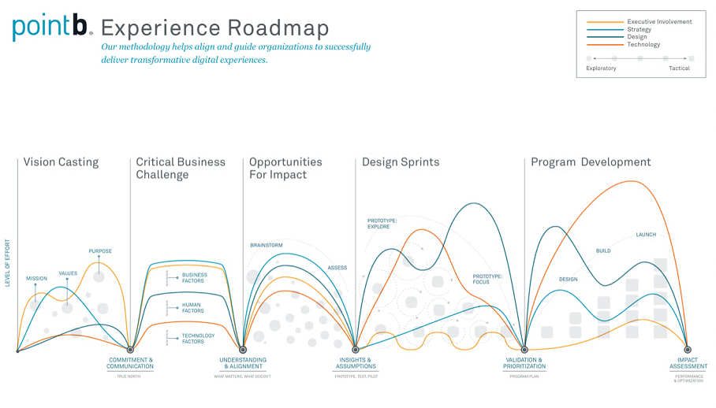
Designing and Governing the Patient Experience
Notes:
Takeaway: Here are specific steps to more thoroughly design and iterate the experience roadmap with the patient in the center. This can help anchor to core patient needs (human factors) and, when organized and led consistently by the same team, can feed a common portfolio governance process.
May want to include a conversation on data governance here
Customer Feedback: What pain points are they experiencing in their journey? Examples:
Appointments: Scheduling and reminders
Navigation: Getting to facility and parking and navigating around the facility
Amenities: At the hospital and nearby
Billing: up front costs, consolidated billing and paying the bill
Information: Pre/post visit instructions, provider information
Communication: Hard to contact; Spanish speaking
Miscellaneous: Check-in and wait times

Slide 13
Focus on Operational Support for Digital Experience

Slide 14
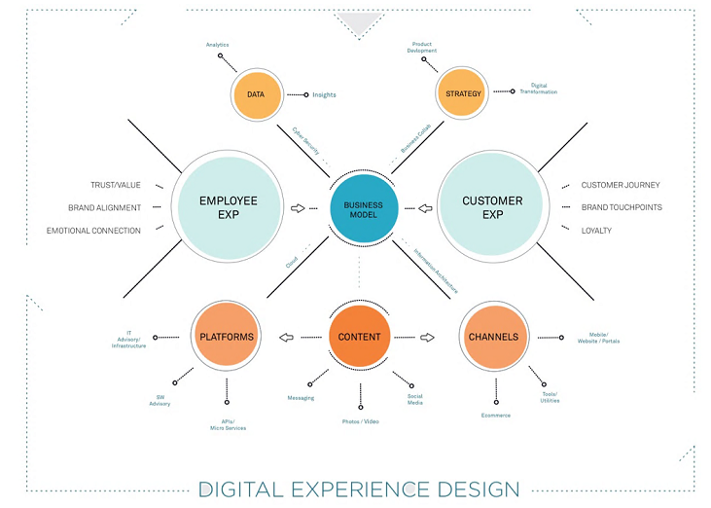
Holistic Digital Experience Design
Notes:
Takeaway: Need to have a holistic approach to integrating this experience with technology, operations and through the organization. This needs to be a thoughtful, strategic approach with consideration of the downstream adoption of these programs.

Slide 15
Begin with Consumer Pain Points
Patients & internal stakeholders identified consumer pain points that could be alleviated by mobile experiences
Pain Points
Appointments
Scheduling appointments
Missed appointments
Navigation
Getting to
the facility
Navigating in
the facility
Parking including payment
Amenities
Hospital lacks amenities
Not aware of hospital amenities and services
Not aware of local amenities
MyChart
Enrollment/ security
Information isn’t there
Lack of response to messages
Billing
Understanding the bill
Paying the bill
Desire to know the cost upfront
Information
Pre-appointment & post-op instructions are unclear
Choosing a doctor
We don’t have ratings
Communication
We are hard to contact
Lack of/inconsistent communication during stay
Non-English speakers
Miscellaneous
Check-in takes too long and is inconvenient
Wait times are too long
Notes:
These are identified pain points/areas of consumer need that digital tools can support. So, how do you get here? Talk to your customers… Internal stakeholders identified consumer pain points that could be alleviated by mobile experiences. This backs up the findings and the consumer surveys.
Next, begin to get more granular.. Transition to building maturity model for each area and prioritizing importance (example on next slide). What operational steps will be need to be completed before your can begin to release digital tools to help alleviate pain points?

Slide 16
Define Experience Use Cases
Experiences |  | Maturity Levels |  |  |  | Goal
 |  | No Capability | Basic Capability | Enhanced Capability | Differentiating Capability
Appointments | Scheduling | Call to schedule appointments. | View past and future appointments. Request via mobile. | Request and cancel via mobile. Set expectations around next available appointment. | Schedule directly via web or mobile. Fast Pass notifications if earlier appointments open. | High Priority
 | Reminders | No appointment reminders sent. | Text message or voicemail reminder sent x days before. | Choose delivery mechanism and quantity of reminders (available in 2017/18 MyChart upgrade). | Reminders have links to wayfinding, personalized instructions, what to expect information, etc.. | Implement via incremental steps
Navigation | Getting to the Hospital | No navigation support. | Static maps and directions. | Link to google maps, which include public transportation options. | Personalized door to door instructions.
 | Navigating the Hospital | No navigation support. | Static maps and directions, printed and web. | Wayfinding via Epic Welcome. | Blue dot wayfinding, beacons to personalize experience. | Delighter. Would compel users to download the app
 | Parking | No parking information. | Maps and instructions on where to park. | Information on parking pricing, discounts, best lot to park for appointment. | Wayfinding to the parking lot is best for appointment. Mark the spot. Wayfinding back to the car.
 | Today |  | Aspirational
Notes:
These recommendations map back to the pain points that were identified by stakeholder interviews and workshops with the core team and capabilities were defined via research and consumer surveys. The farther right on the scale, the richer the experience is for the consumer.
Build out the digital maturity models for each critical functionality. Then consider, where does your organization want/need to be. Begin to consider how to deliver operationally. Could take one of these and walk through an example of the operational support needed. Online scheduling is a good example. Requires cleaning up visit types, visit blocks and getting provider buy-in to offer open scheduling

Slide 17
Clear understanding of the buy vs build
Notes:
We’ve discussed:
Consumer-centric trends in retail that deliver great experiences. That included bridging the physical – digital world to drive a unified experience. How technology has become pervasive in both the consumer touchpoints, but also in operational delivery. Key points included a mobile first delivery and the personalization of content and experience.

Slide 18



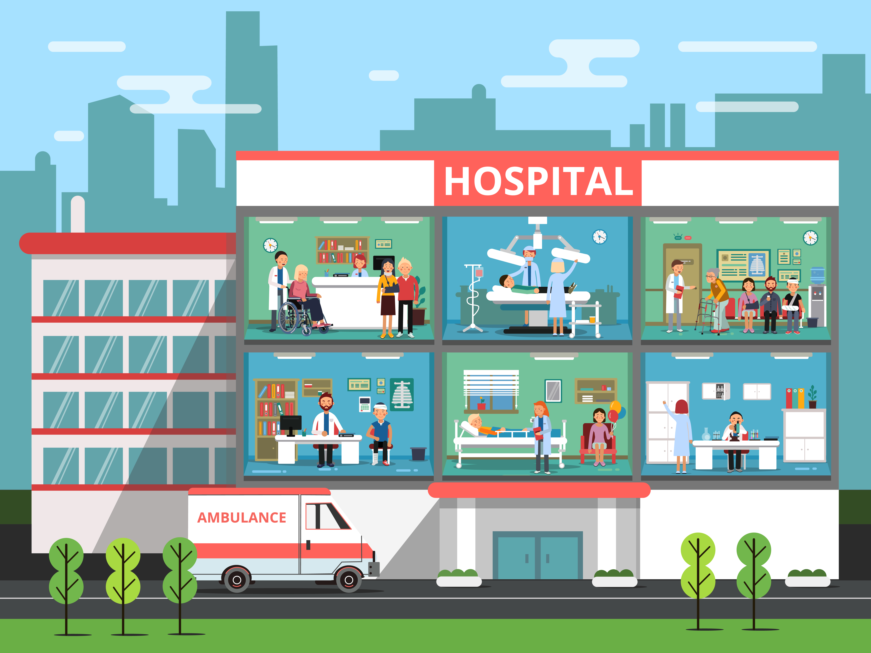
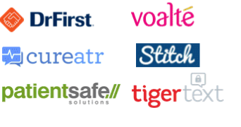
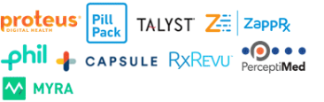


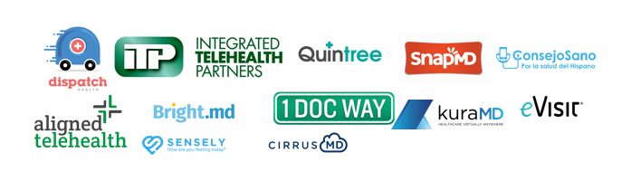
Tech start-ups are addressing nearly every aspect of care
Care Management
Patient Engagement
Scheduling & Referrals
Patient Communication
Pharmacy
Diagnostics
Hospital Wayfinding
Telehealth & Virtual Health
Notes:
This is noisy, overwhelming.
Fundamentally this image is indicative of the opportunity to improve the delivery of care and the patient experience. Literally hundreds of companies have been built to address these challenges.
Most of our clients find that they need help navigating these populated waters.
To prioritize real pain points; what is the value to patients and stakeholders?
Analyzing the feedback and identifying what solutions make sense for them. You can build it or you can buy it. Each comes with advantages and disadvantages.

Slide 19
Vendor Selection Approach

Slide 20
Organizational Change Management Approach
Notes:
We’ve discussed:
Consumer-centric trends in retail that deliver great experiences. That included bridging the physical – digital world to drive a unified experience. How technology has become pervasive in both the consumer touchpoints, but also in operational delivery. Key points included a mobile first delivery and the personalization of content and experience.
People, processes and technologies enable great consumer experiences. Again, bridging the physical and digital… but considering the enablement of great experiences through technology and also operational alignment with technology. Consumer-centric organizations form the backbone to successfully marrying these people, processes and technology.

Slide 21
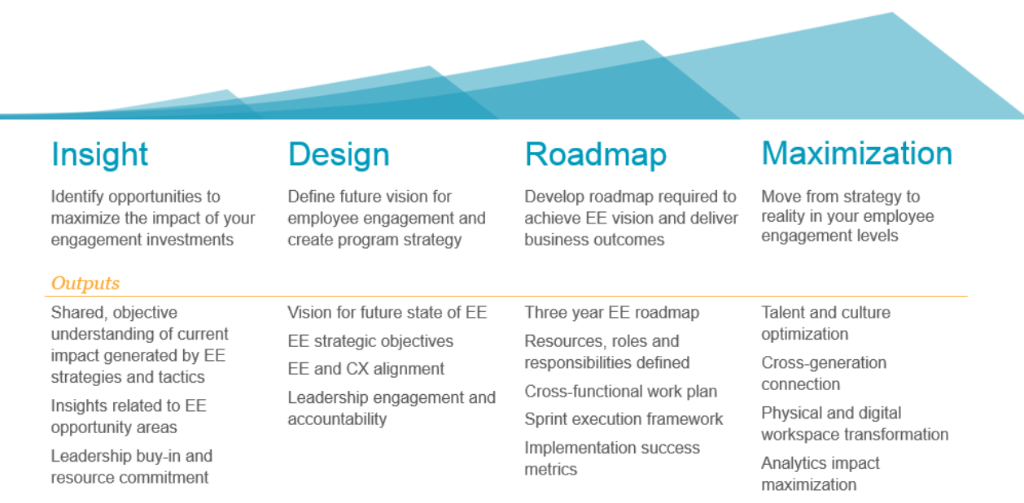
Change Management Approach

Slide 22
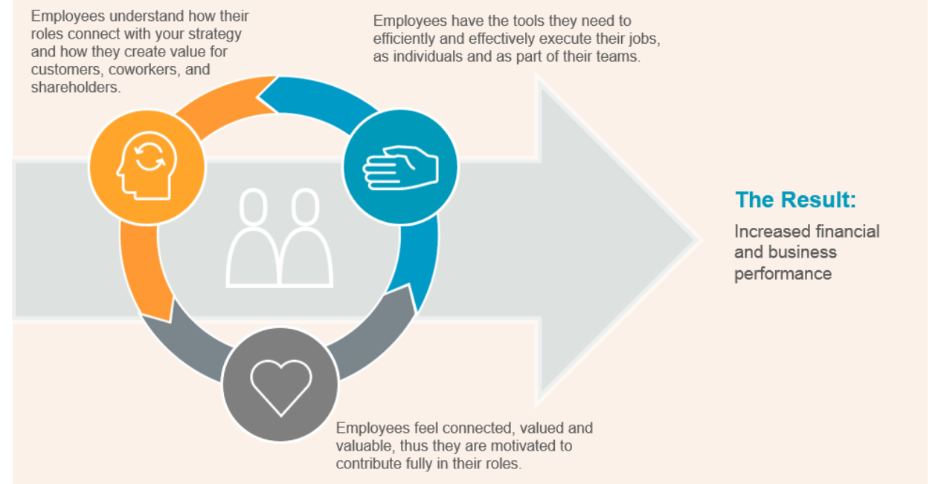
Employee Engagement Approach
Increased Engagement & Adoption

Slide 23






What did we talk about?
Know Your Customer
Establish Comprehensive Patient Experience Governance
Parallel Focus on Operational Support for Digital Experience
Development and Support Approach
Appropriate Organizational Change Management Approach
Notes:
Know your Customer: Utilize consumer surveys, industry and competitive research, stakeholder interviews and work collaboratively as a team to understand pain points, develop a strategy and a roadmap for the patient experience.
Establish Comprehensive Mobile Governance – Prioritization of a common roadmap by a single governance structure allows the organization to more effectively roll out seamless experiences.
Parallel Focus on Operational Support for Digital Experience – The need to offer experiences that healthcare consumers are expecting (appointment scheduling, bill pay, prescription refill, messaging) as well as experiences that will delight (personalized information, wayfinding, ease of use) depends upon operational improvements.
Development and Support Approach – Before more comprehensive roadmaps can be developed, there needs to be a clear understanding of the buy vs build development methodology, resourcing constraints and funding. Developing and supporting a mobile platform is a long term commitment.
Appropriate Organizational Change Management Approach – Consumer adoption cannot be expected without organizational adoption. A comprehensive Organizational Change Adoption plan should be in place.

Slide 24


Q&A

Slide 25






Healthcare Experience
Who We Are
Our Work
Our Clients
200+
  Healthcare Delivery Systems
  Integrated Health Systems
  Community Hospitals
  Academic Medical Centers
  Physician Organizations
  Large Specialty Practices
  Healthcare Services
  Health Plans
  Life Sciences
3000+
Healthcare engagements
Consultants Working with Healthcare Clients
20+
Years of experience
working in Healthcare
200+
Healthcare Clients Served
Word On The Street
Our Expertise
Our Representative Projects
  “Point B combines healthcare IT expertise with a down-to-earth, human approach.”
- VP of Finance, community hospital & medical group
  Value Based Care
  Healthcare IT & Analytics
  Operational Optimization
  & Cost Reduction
  Regulatory Compliance
  Consumerism, Retail
  & Digital Health
  Cybersecurity
  Mergers and Affiliations
  Next-generation Population Health
  Hospital system cost reduction
  Value-added regulatory compliance systems
  Healthcare consumer experience strategy

