Slide 1
2018 State Legislative Session
Results & Next Steps
Andrew Busz, FAHM
Policy Director Finance, Washington State Hospital Association

Slide 2

Objectives
Understand the policy successes and opportunities moving forward
Understand what happened to health care in the supplemental budget
Next steps: Implement, seek our own solutions, and plan for 2019

Slide 3
2018 Political Climate & Context
One-Party Control

Slide 4


Leadership
Governor Jay Inslee (D)
- Easily re-elected to second term
House Speaker Frank Chopp (D)
- Maintains narrow majority
  Rep. Eileen Cody (D) continues as chair of House Health Care
  Rep. Tim Ormsby (D) new chair of House Appropriations
Senate Majority Leader Sharon Nelson (D)
- New narrow majority
  Sen. Annette Cleveland (D) new chair of Senate Health and
  Long Term Care
  Sen. Christine Rolfes (D) new chair of Senate Ways and Means

Slide 5
Policy and Budget Results
Notes:
RHONDA
Thank you, Chris for setting the stage.
Now, let’s move onto a discussion of what we were trying to achieve this session, and more importantly, the results!
Chelene?

Slide 6
2018 Legislative Priorities www.wsha.org/policy-advocacy/state-legislative-agenda/
Ensure that hospitals can be stable institutions in their communities, long into the future.
Within a safety-focused regulatory environment, maintain the flexibility to respond to changing needs and opportunities to improve care.
Make it easier to meet patient needs in lower-cost and non-hospital settings.
Advocate for patients and hospital employees.

Slide 7
Bills WSHA Worked this Session
Passed - Supported | Died – Supported | Died - Opposed | Died - Neutral
Charity care clarifications | Opioids (+10 bills not all supported) | Nurse meal/rest breaks & no use of call | Peer review expansion
Body-worn cameras protection | Advance directives | Extensive reporting of mergers, etc. | 90/180 patients in hospitals
Telemedicine pilot | Expanded informed consent | Restrict balance billing | CN changes for ASFs
Permitting video for ITA mental health hearings | Ricky’s law delay | Wrongful death expansion | Restricting/prohibiting non-competes
Individual market PEBB/SEBB bill | Reinsurance for individual market | Limiting a hospital’s ability to manage and standardize care
ARNP/PAs in hospitals (neutral) | Firearm regulation by local governments | Facility fee notice
Sexual assault nurse examiner study |  | Penalty related to availability of sexual assault exams
Service animals misrepresentation
Notes:
Chris – Politics, pent up demand
Chelene - Breadth

Slide 8
2018 Session Policy Successes
Charity care
Opioids
Body-worn cameras in hospitals
Pilot for telemedicine parity
Service animals
Study on sexual assault nurse examiners
Individual market coverage

Slide 9
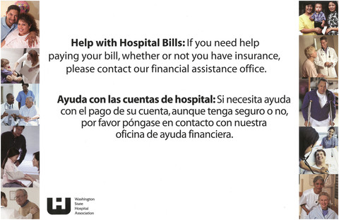
Charity Care (SB 6273)
Amends state charity care law:
  Increases standardization regarding notice to patients of the availability of charity care
  Requires staff training on charity care policies and interpreter services
  Clarifies definitions
Effective October 1, 2018
Department of Health rulemaking

Slide 10

Opioids
Several bills introduced: ranged from new mandates on providers to increasing funding
No opioid bill ended up passing, but important funding for medication-assisted therapy and other services in the budget
Notes:
Chris – pill counts

Slide 11
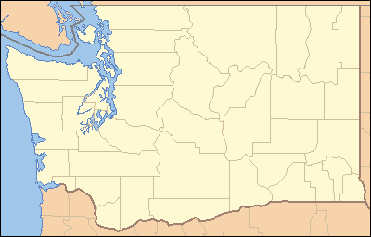

Individual Market Coverage (HB 2408)
For 2019 creates a subsidized high-risk pool option for counties with no individual market coverage
For 2020 and beyond, requires insurers participating in the school or public employee benefit plans to also offer individual market coverage

Slide 12
Pilot for Telemedicine Parity (SB 6399)
Directs the telemedicine collaborative to make recommendations by Dec. 1 on a pilot to test payment parity for the following services:
  Diabetes mellitus,
  stroke,
  mental health conditions,
  opioid dependence and
  chronic pain.

Slide 13
Service Animal Misrepresentation (HB 2822)
Bill defines “service animal” as a dog or miniature horse individually trained for the purpose of assisting or accommodating a sensory, mental, or physical disability.
Institutions must provide access for service animals but are not required to do so for other animals.
Establishes penalties if a person misrepresents an animal (such as a ‘comfort animal”) to be a service animal.

Slide 14
Body-worn Cameras (SB 6408)
Applies to body-worn cameras worn by law enforcement at hospitals and health care facilities
News media wants access to camera footage, putting patient privacy at risk.
Bill preserves privacy protections for body-worn camera recordings that would otherwise have sunset on July 1, 2019.

Slide 15
Issues We Successfully Opposed or Negotiated
Nurse meals and breaks/pre-scheduled on-call
Mergers and affiliations
Wrongful death
Balance billing
Noncompete agreements
Limiting a health care entity’s ability to manage and standardize care

Slide 16
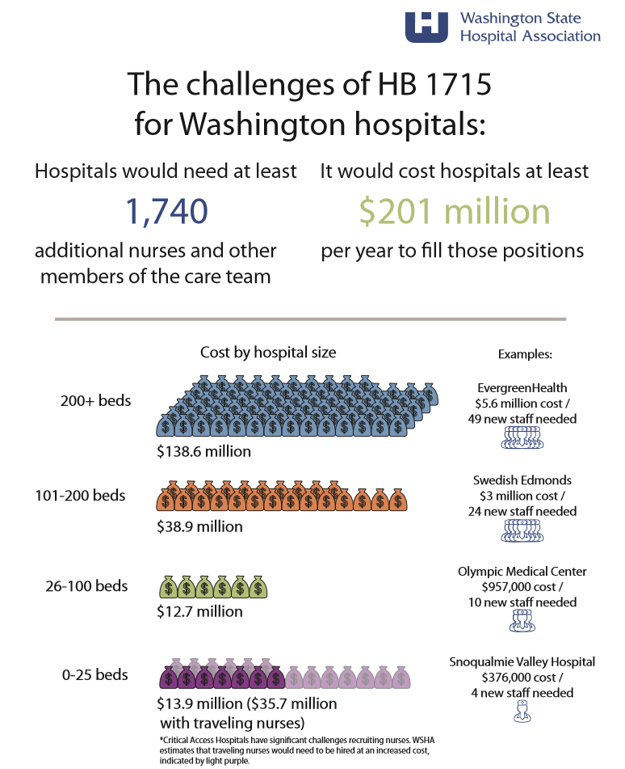
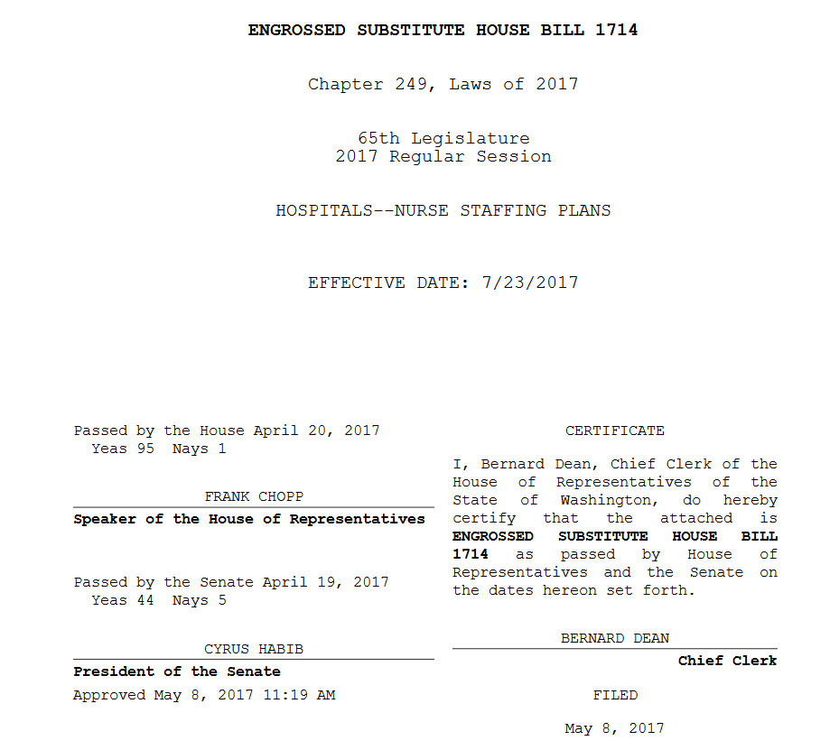
Nurse Meals and Breaks (HB 1715)
Would have mandated uninterrupted meal and rest breaks, prohibited the use of pre-scheduled on call and expanded mandatory overtime prohibitions
THANK YOU FOR YOUR ADVOCACY!
What you should be doing now

Slide 17
Partnerships and Affiliations (HB 1811)
Would have placed significant new requirements on hospitals:
  Burdensome reporting to the Attorney General of almost all transactions - even simple arrangements, such as contracted services
  Require health care entities to divulge sensitive, proprietary transaction details
  Treble damages under the Consumer Protection Act
Singles out the health care industry and slippery slope toward additional reporting and regulation

Slide 18
Wrongful Death (SB 6015/HB 2262)
The Ride the Ducks accident illustrated limitation of our state’s wrongful death statute
WSHA did not oppose expansion to non-US residents, but strongly opposed:
  Significant expansion of damages
  Exposure for “deep pocket” defendants under state joint and several liability standard
  Removal of economic tie

Slide 19
Balance Billing (HB 2114)
Would have protected consumers from balance billing charges, but created significant administrative burden, cost and liability for hospitals
Unresolved issues:
  Agreement on default payment rate in absence of a contract
  Self-funded and other health plans not subject to OIC regulation
What you should be doing now

Slide 20
Penalty Related to Sexual Assault Examination Availability (HB 2585)
Sexual assault sample collection requires special forensic training not available at all hospitals.
Bill would have imposed an unreasonable penalty on hospitals related to providing notice of the availability of forensic evidence kit collection.
WSHA supported HB 2101, which directs a study to increase availability and access to sexual assault nurse examiners nationwide.

Slide 21
Noncompetition Agreements (HB 2903/SB 6522 & SB 6526)
Would have limited the use of noncompetition agreements, which are used by many hospitals and medical groups to protect investments to help relocate and support physicians
What you should be doing now
Notes:
Zosia

Slide 22

Limiting a Health Care Entity’s Ability to Manage and Standardize Care (SB 6247/HB 2482)
Would have undermined hospitals’ ability to plan for and provide for health services in their community
Would have created many disagreements about quality and patient safety

Slide 23

2018 Supplemental Budget
Revenues were up
No cuts to hospitals
The budget includes significant funding for K-12 education — $700 million — as well as some funding for behavioral health
More than $150 million in mental health, most investments in state hospitals, but partial hospitalization not funded.
Modest increases for opioid work
Payment increase for pediatric primary care and a study of access

Slide 24
2018 Supplemental Budget Highlights
Issue | Final Budget
Opioids | $4.4 million state/$16.5 million total funds
Medicaid physician pediatric primary care rate increase (does not apply to RHCs or FQHCs) | $5.8 million state/$13.8 million total funds
State psychiatric hospitals | $105.5 million state funds
Community mental health BHO rate increase Children’s long term beds IMD backfill Crisis reserves Partial hospitalization programs | $23 million state/$69.3 total funds $2 million state/$4 million total funds $3.3 million state funds $14.5 million state funds Not funded
Restores unrealized savings from Healthier WA | $30.2 million/$67.7 total funds
Restores unrealized savings preferred drug list | $11.5 million state/$39 million total funds
WHRAP and rural transformation study | Transferred funds/study for all rural hospitals
WSHA budget chart: http://www.wsha.org/wp-content/uploads/2018-Final-supplemental-budget-CHART_3.7.2018.pdf

Slide 25
Interim Work and 2019 Planning

Slide 26

Interim Policy Work: Implementation
Participate in the rule making process, convene members to monitor impact and give feedback, etc.
  Charity care
  Opioids
  Nurse staffing – 1714 from 2017 session
  Mental health
Notes:
Zosia

Slide 27
Possible Legislative Priorities for 2019
Many issues will be returning from 2018, in addition:
  Community Safety
  Rural transformation
WSHA Public Policy Committee has set the direction for major budget issues:
  Difficult to discharge patients
  Work force
  Outpatient Medicaid rates
  Partial hospitalization: mental health

Slide 28
Thank You!
Questions? Comments?
Andrew Busz
andrewb@wsha.org  206-216-2533

